Slide 1
KEVA ANTI POLLUTION DROPS
KEVA
INDUSTRIES
Brings First Time In India
In Joint Venture with
KANID BIOTECH
TOKYO, JAPAN

Slide 2
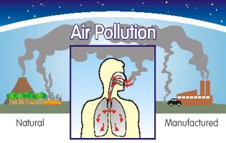
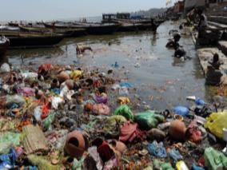
Problem OF POLLUTION
Day to day pollution has decreased our life span
As Water & Air, the two essential elements on which all life depends, have become global garbage cans.

Slide 3
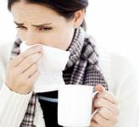
Health Problems
Cough, cold, fever, flu, etc. have become common daily problems from which we are not being able to see any respite.

Slide 4
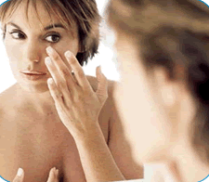
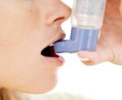
Health Problems
In recent times, these problems have lead to serious diseases of cancer, chest congestion, skin problems, tuberculosis, hypertension, depression & a never ending list.

Slide 5
Can we stop the earth from air, water pollution ??
No!
Then will we have to survive with such serious diseases lifelong?
WE WILL AGAIN SAY NO!
YES, BECAUSE WE NOW HAVE THE SOLUTION TO ALL THESE PROBLEMS!!

Slide 6
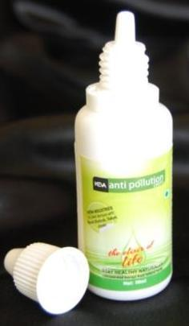
KEVA INDUSTRIES has brought this solution to you in joint venture with KANID BIOTECH, based in Tokyo, Japan.
SOLUTION
KEVA ANTI POLLUTION DROPS

Slide 7
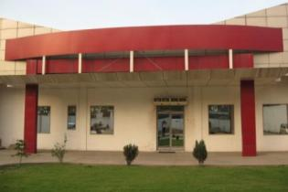
ABOUT KEVA INDUSTRIES
Keva Industries is an ISO 9001:2008 certified company which is a leading developer and supplier of wellness and healthcare products in India.

Slide 8
About Keva Anti Pollution Drops
(KAPD)
A 100% Natural & Herbal Remedy
Concentrated Extract from Japanese Natural Herbs

Slide 9
A kind of ‘Elixir of Life’ which promotes longevity
Anti-cold, cough, fever, Anti-Bacterial, Anti-Infective, Immuno Modulator, Anti-Microbial

Slide 10
What is Keva Anti Pollution Drops ?
(KAPD)
KAPD is a highly concentrated & a natural extract of different Japanese herbs.

Slide 11
What is Keva Anti Pollution Drops ?
(KAPD)
These Japanese Herbs have been traditionally employed in hundreds of different formulations for over 5000 years for the treatment of a wide range of disorders

Slide 12
KAPD is rich in antioxidants
KAPD is a vitalizer, rich in antioxidants & renowned for its restorative powers
Antioxidants are an important part of maintaining a healthy diet and lifestyle

Slide 13
KAPD is rich in antioxidants
It is a great body balancer having extremely powerful antioxidant properties that helps regulate body functions containing the most ‘Exotic Japanese Herbs’ for a prognosticating advancement in health

Slide 14
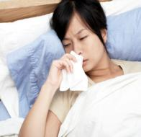
Benefits of KAPD
Fights common cold, cough
Supports immune system
Diminishes symptoms of flu & fever
Rejuvenates respiratory problems
Optimizes physical performance
Promotes healthy metabolism

Slide 15
Benefits of KAPD
Combats the harmful effects from pollution in air or water
Helps to relieve from stress (adaptogenic)
Treats fungal infections
Works as a defense invading bacteria & virus
Promotes healthy metabolism
Enhances stamina

Slide 16
Need & Importance of KAPD
KAPD is a premier adaptogen.
It helps the body and mind to adapt and cope with a wide range of physical, emotional and infectious stresses.
It restores disturbed physiological and psychological functions to a normal healthy state.

Slide 17
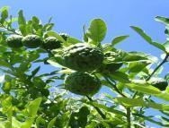
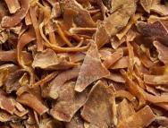
WHAT KAPD CONTAINS ?
KAPD is an excellent source of Energy, Protein, Carbohydrates, Dietary Fiber & a good source of Niacin, Pantothenic acid, Pyridoxine, Riboflavin & Vitamin E.
In addition KAPD is a good source of Thiamin, Vitamin A & Vitamin K.

Slide 18
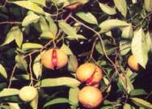
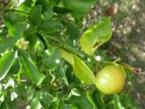
WHAT KAPD CONTAINS
It is a natural extract obtained from Surballari, Myristica fragrans, Citrus aurantifolia, Cyprus rotundas oil, Aloe barbadensis.

Slide 19
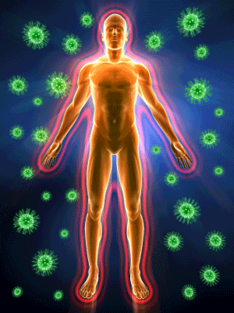
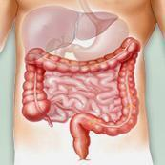
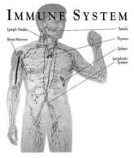
How KAPD works ?
When KAPD is taken, the body starts to get cleansed & the body frequently begins to eliminate toxic wastes.
KAPD helps the human body regain its equilibrium at the cellular & organic level by providing support to the immune and other systems.

Slide 20
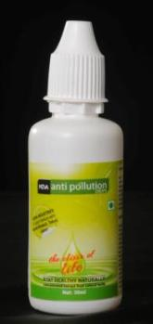
How KAPD works ?
KAPD shall not be considered as any medicine as it is complete, all 100% natural and pure, unlike chemically synthesized, highly concentrated drugs that may produce many side effects.
KAPD can effectively realign the body's defenses as it offers a way to put the body in proper tune with the nature & maintain a proper balance.

Slide 21
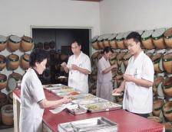
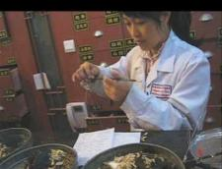
Brief History
The use of herbs for medicinal purposes is as old as our civilization.
In the written record, the study of herbs dates back over 5000 years back.

Slide 22
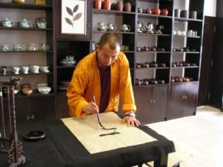
Brief History
Herbs have been used for uncounted times for various purposes like healing the sick and infirm since these have excellent anti-viral, anti-bacterial, anti-fungal & anti-helminthic properties.

Slide 23
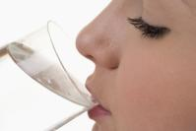
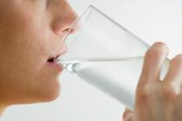
How to use KAPD
Age wise Daily Dosage
Age: | Dosage:
7-13yrs | 1 drop morning 1 drop evening
14-17yrs | 2 drop morning 2 drop evening
18yrs & above | 5 drop morning 5 drop evening

Slide 24
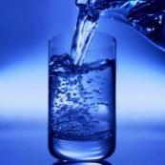
Dos’ & Don’ts while taking kapd
For best results, KAPD should be taken twice daily, i.e. morning & evening.
Mix it with tea, coffee, milk, and water or take orally.

Slide 25
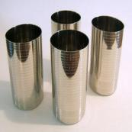
Dos’ & Don’ts while taking kapd
Wait at least half an hour before drinking alcohol or eating etc. These can cancel out the effectiveness of KAPD.
Do not drink KAPD in steel or any other metal glass. Use glass tumblers or ceramic pots only.

Slide 26
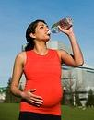
Dos’ & Don’ts while taking kapd
It is not recommended for children upto 7 yrs, pregnant and lactating women
Moderately increased dosages are safe if needed or required, but larger amounts may cause a laxative effect

Slide 27
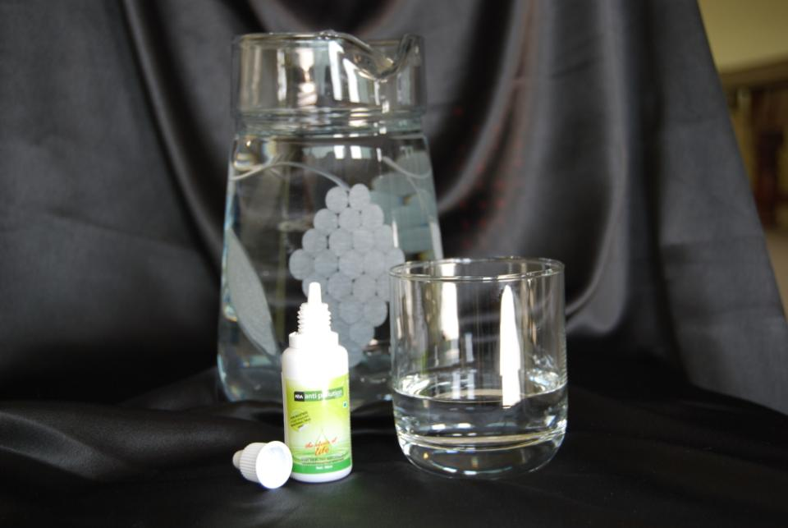
Dos’ & Don’ts while taking kapd
It is extremely essential to drink a plenty of water throughout the day. Drink minimum 3 liters of water.
For better results use KAPD twice daily for 6-12 months.

Slide 28
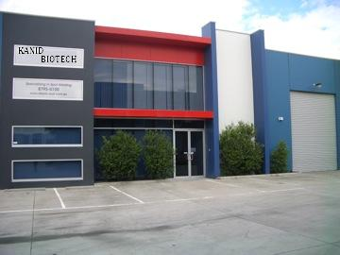
Keva Anti Pollution Drops (KAPD) is a quality product introduced first time in India in joint venture with KANID BIOTECH based in TOKYO, JAPAN

Slide 29
KANID BIOTECH is a leading & renowned name in Japanese ancient herbs in Japan as well as the entire world

Slide 30
The staff of KANID BIOTECH is highly qualified & committed

Slide 31
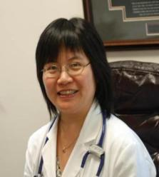
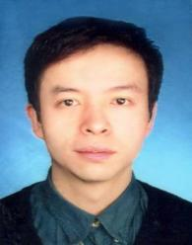
Scientific Board of KANID BIOTECH
DR. TAAKESHI KYOTAA
PhD in Herbology/ Researcher- Natural & Ancient Herbs
DR. CHO INOUE
Expert in Japanese Herbs
DR. DAI SHIMIZU
Practitioner & Trainer in Kanid Biotech for use of natural extracts in Medicine

Slide 32
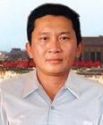
Testimonials
Working in highly polluted areas with excessive traffic had lead to problems of throat along with frequent cough. My situation started getting worse. Then somebody told me about Keva Anti Pollution Drops. It worked wonders in just 10 days. I am consuming it for last 2 months & feel great!
Hiroshi Takahashi
Male
Age:40 yrs
Osaka, Japan

Slide 33
Testimonials
I am allergic to dust & from past some time I was suffering from severe cold. One day I came to know about Keva Anti Pollution Drops & thereafter started taking the drops twice daily. In 5-7 days I felt a lot of difference.
Harumi Saito
Female
Age: 32 yrs
Tokyo, Japan

Slide 34
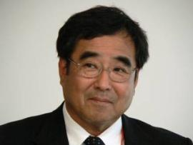
Testimonials
For past 30 yrs I am working in a dying factory. For last 2 yrs I had started suffering from cough & chest congestion. But after I started taking KAPD, I was relieved from the problem of cough in just a month. Now I feel a new energy in myself.
Nobuo Oonishi
Male
Kyoto, Japan
Age: 50 yrs

Slide 35
Testimonials
I am always allergic to dust. For quite some time I felt that pollution is increasing in our surrounding which had increased my problem. One day I fainted while doing dusting at home. When I came in conscience my daughter who is doing masters in natural medicine about Keva Anti Pollution Drops. From that day I am very much normal.
Kamiko Kinjo
Female
Yokohama, Japan
Age: 45 yrs

Slide 36
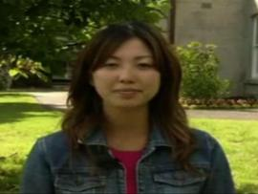
Testimonials
I travelled a lot & started suffering from cold, headache, watering eyes etc. One day some one told me about the importance of herbs & Keva Anti Pollution Drops. I started consuming the same day & now I am absolutely fine & can manage all my stress very well.
Naomi Sakamoto
Female
Nagoya, Japan
Age: 20 yrs

Slide 38
Contact: Keva Industries An ISO 9001:2008 Certified Company Level 2, Prestige Omega, No. 104, EPIP Zone, Whitefield, Bangalore-560066 (India) Web: www.kevaind.org

Slide 39
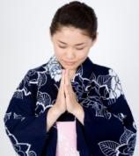
THANK YOU
Note: This product is not intended to treat, cure or prevent any disease. Please consult your health care professional.

