Slide 1
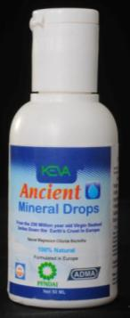
Keva Industries Introduces Keva Ancient Mineral Drops Produced under GMP Regulations
In Collaboration With
UK Based Nayo Pharma

Slide 2
Best Beauty Product That Accentuates Your Skin
Makes You Feel Rosy & Beautiful

Slide 3
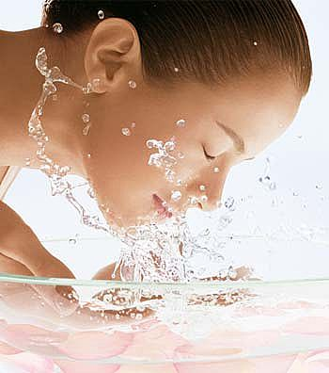
Gives Clear & Smooth Skin Texture
Rejuvenates Your Skin
Skin Automatically Flourishes & Thrives

Slide 4
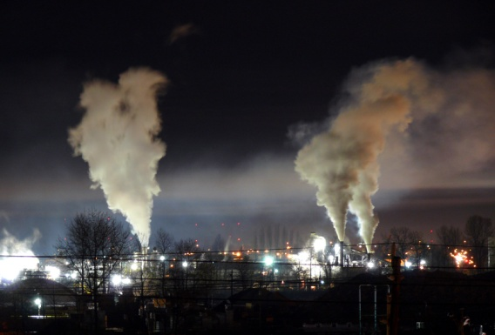
External Factors Causes Skin Problems
Industrial Pollution
Air pollution
Germs(Bacteria , Fungus etc)

Slide 5
Internal Factors Causing Skin Problems
Hormonal Imbalance
Inadequate Diet
Deficiency of Minerals
Sleeplessness
Stress

Slide 6
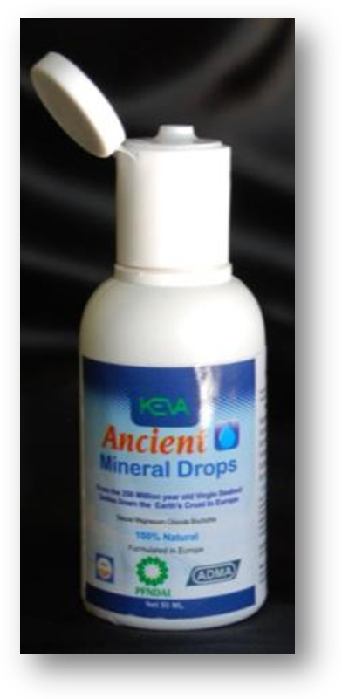
Keva Industries Introduces
Keva ancient Minerals Drops
To Give Healthy & Radiant
Skin Texture

Slide 7
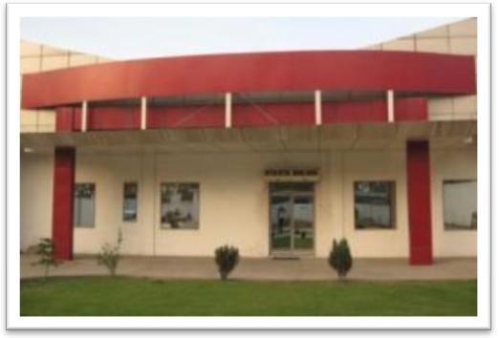
ABOUT KEVA INDUSTRIES Keva Industries is an ISO 9001:2008 certified company which is a leading developer and supplier of wellness and healthcare products

Slide 8
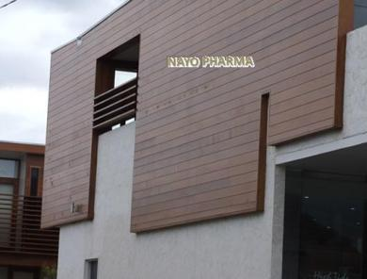
Keva Ancient Mineral Drops (KAMD) is an excellent product introduced first time in India under license from NAYO PHARMA based in LONDON, UNITED KINGDOM

Slide 9
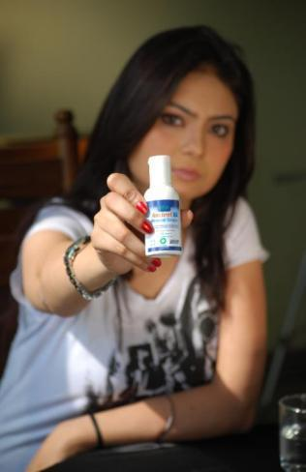
KAMD contains 84 ionic trace minerals
100 % Pure & Natural Product
Completely Free From Any
Side Effects

Slide 10
KAMD Has Got Worldwide Appreciation
World famous HALAL Certified Product
International Quality Excellence Award From WEPS

Slide 11
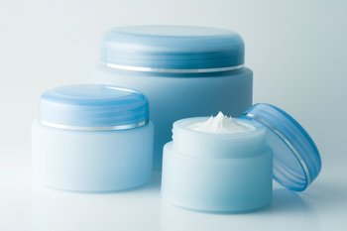
KAMD contains 84 rich and natural ionic minerals which gives complete nourishment to the skin
That cannot be covered through any cosmetic product, natural gel and cream available in the market.

Slide 12
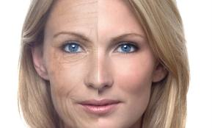
Fights Against Aging
Makes You Feel Young
Prevents Early Aging & Gives you Wrinkle Free Skin

Slide 13
Uneven Skin & Dullness
KAMD also gives proper exfoliation to the skin that whitens and smoothens your skin by removing dead skin cells

Slide 14
Itchy Skin & Blisters
KAMD gives Midas touch to uneven skin and makes your skin smooth and silky

Slide 15
It has very gentle and cleansing effect on the skin and protects your skin from various infections

Slide 16
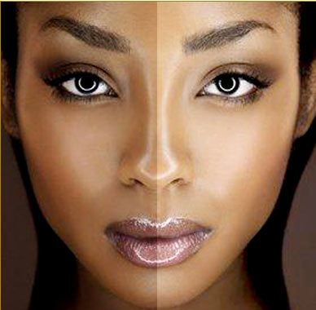
Hyper- Pigmentation
Few Drops of KAMD can help you by whitening your dark pigments on the skin, improves color and provides natural fairness, and you can get clear & glowing skin.

Slide 17
You can enjoy Beautiful & healthy complexion.

Slide 18
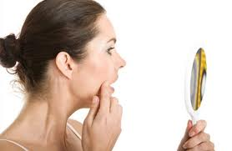
Skin Blemishes
KAMD plays vital role in reducing stress and regulating hormonal functions in the body.
Use KAMD and forget
blemishes.

Slide 19
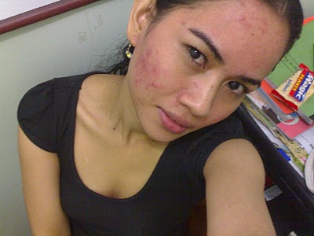
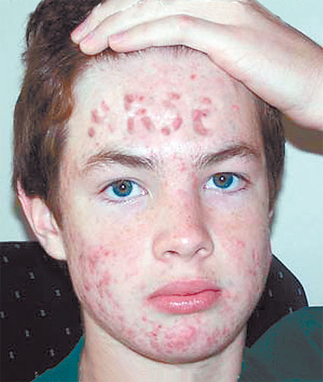
Acnes, Pimples
KAMD gives you clear
and smooth skin texture.

Slide 20
Fight confidently against acnes and other skin problems with KAMD.

Slide 21
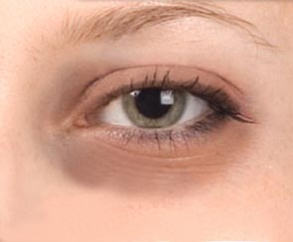
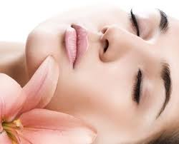
Dark Circles
You can get rid of these horrifying dark circles through KAMD as it detoxifies and rejuvenates your skin

Slide 22
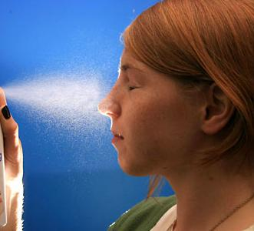
Way Of Using KAMD
Proper and regular dosage of KAMD is of paramount importance.
When applied through spray or drops, it is quickly absorbed by the skin whilst, accentuating the skin.

Slide 23
It is recommended to be used daily morning and evening after shower for getting excellent results.
Properly massage your skin with gentle and circular movements for the time till your skin completely absorbs it as every skin has its own absorption capacity.

Slide 24
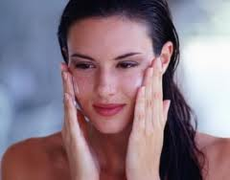
KAMD penetrates the skin quickly,
and makes feel rosy and
beautiful.
While using spray bottle fill 50ml of water upto mark (_{=>}) on label.
Mix 40 drops of KAMD and shake well to mix.

Slide 25
Thoroughly spray the solution on face & neck skin.
If you don’t get results
then increase the dosage
from 40 to 80 drops and
use it continuously.

Slide 26
On pimple, acnes you can directly apply single drop on the particular infected area, and properly massage it and leave it overnight for excellent results.

Slide 27
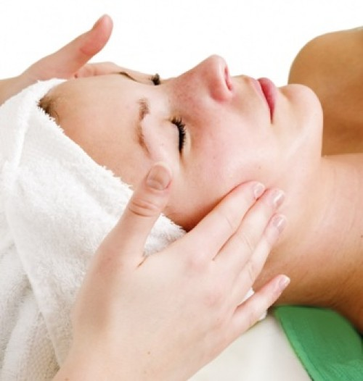
If any irritation persists while using KAMD, decrease the dosage initially. After using for some days, skin will handle KAMD better. Then you can moderately increase the dosage.

Slide 28
With KAMD Enjoy Natural Beauty & Say Good Bye To All Skin Problems

Slide 29
Testimonials
Acne
With the regular use of KAMD, I got much relief from skin rashes, acne problem and blemishes. Before using this product I was continuously trying to deal with this problem for so many years but of no use. I went through so many skin treatments to get healthy and beautiful skin. But I was not getting relief from any therapy. And just three months back I started using KAMD, which really sorted out my skin problem, my complexion lightened and it gave me a healthy and glowing skin. Now I love myself all because of KAMD!
Maheshwari Nair
(Age-26yrs)
( Venikulam, Kerala)

Slide 30
Wrinkles & Dark Spots
I've recently started using the Keva Ancient Mineral Drops. I've always used various skin care products for wrinkle free and clear skin but when I started having skin problems I panicked and thought I needed something natural. They made the problem so much worse. Since then, I've gone back to natural and I have seen so much improvement with this KAMD. My wrinkles, dark spots and ugly pimples have gone to a large extent. I and my skin both are so thankful to KAMD!!
Mandeep Kaur
(Age-27yrs)
(Rupnagar, Punjab)

Slide 31
Blemishes & Hyper-Pigmentation
I got such a relief because of KAMD from ugly blemishes & skin darkness. Actually my skin is very sensitive and I used number of natural creams & other beauty products but nothing proved beneficial. But KAMD is such an innovative & effective product that I still can’t believe my problem has gone really. God Bless KAMD Team!
Amenda Philips
Age-35 Yrs
Dublin UK

Slide 33
Contact: Keva Industries An ISO 9001:2008 Certified Company Level 2, Prestige Omega, No. 104, EPIP Zone, Whitefield, Bangalore-560066 (India) Web: www.kevaind.org

Slide 34
Note: This product is not intended to treat, cure or prevent any disease. Please consult your health care professional.

