Slide 1
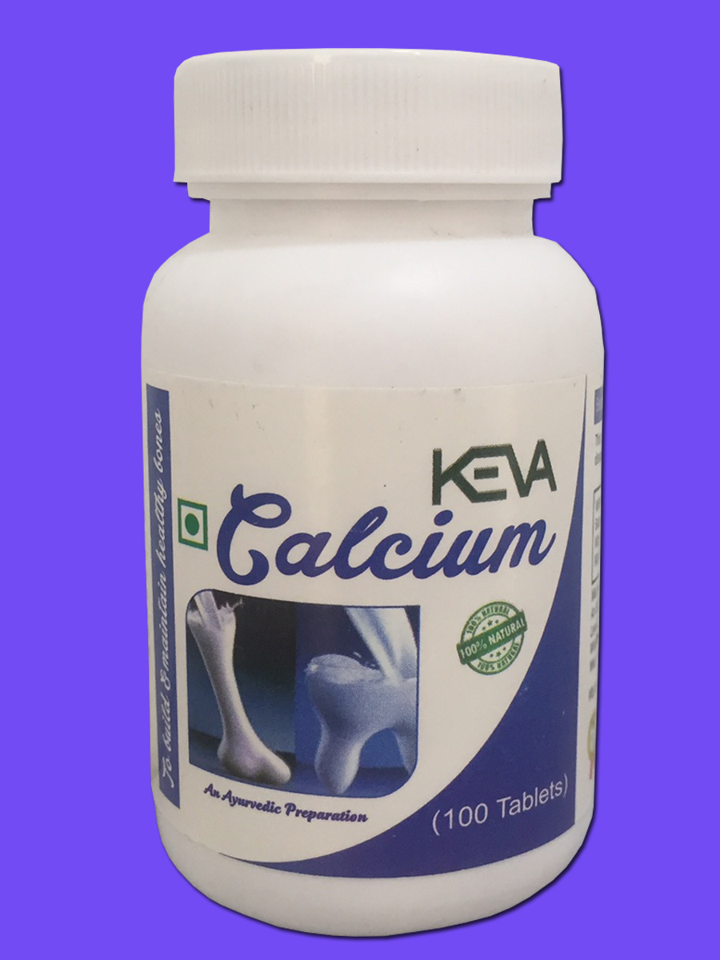
Keva Industries has launched
Keva
Calcium
Demo
MRP: Rs. 299/-
Pack Size: 100 Tablet

Slide 2
Calcium
Calcium is a mineral important for strong bones & teeth.

Slide 3
Calcium
Too little calcium can lead to rickets & osteoporosis. Calcium can increase bone density & helps to reduce the chances of fracture in older women & men. Calcium also reduces the risk of osteoporosis in early ages.

Slide 4
Calcium
Calcium also has a role in blood clotting & the regulation of muscle contractions including the heartbeat. Studies also suggest that calcium has a role in managing blood pressure & preventing breast & colon cancer.

Slide 5
Keva Calcium
Keva Industries has recently launched Keva Calcium Tablets with packing of 100 tablets in healthcare segment.
It is HALAL & Kosher certified & has been produced under GMP guidelines.

Slide 6
How to use Keva Calcium?
Take 1 tablet twice a day morning & evening on an empty stomach or half an hour before meal.
This product is not intended to treat, prevent, cure or diagnose any diseases. Please consult your healthcare physician.

Slide 7
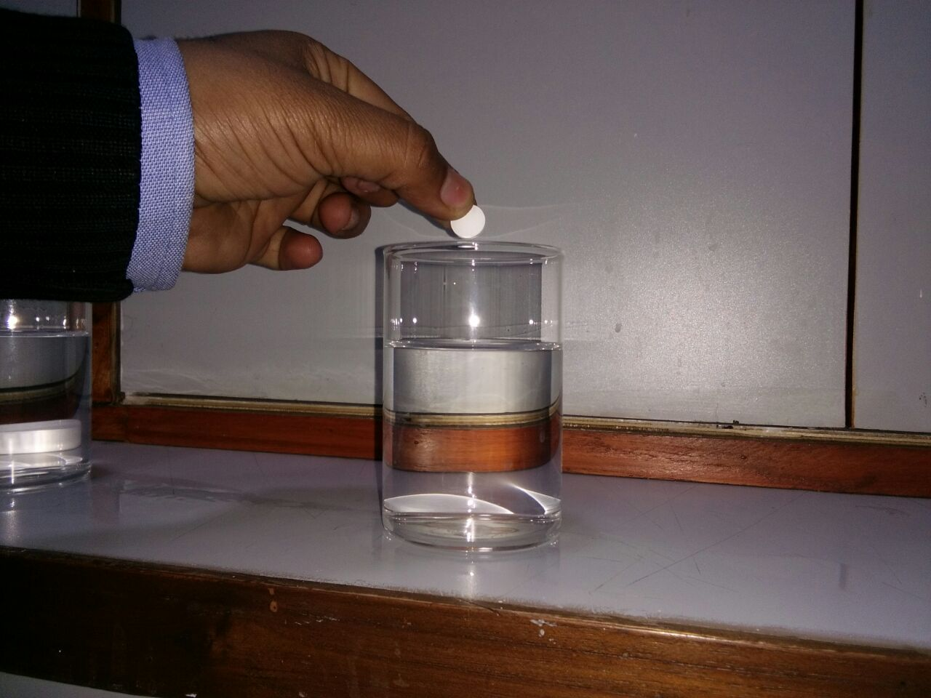
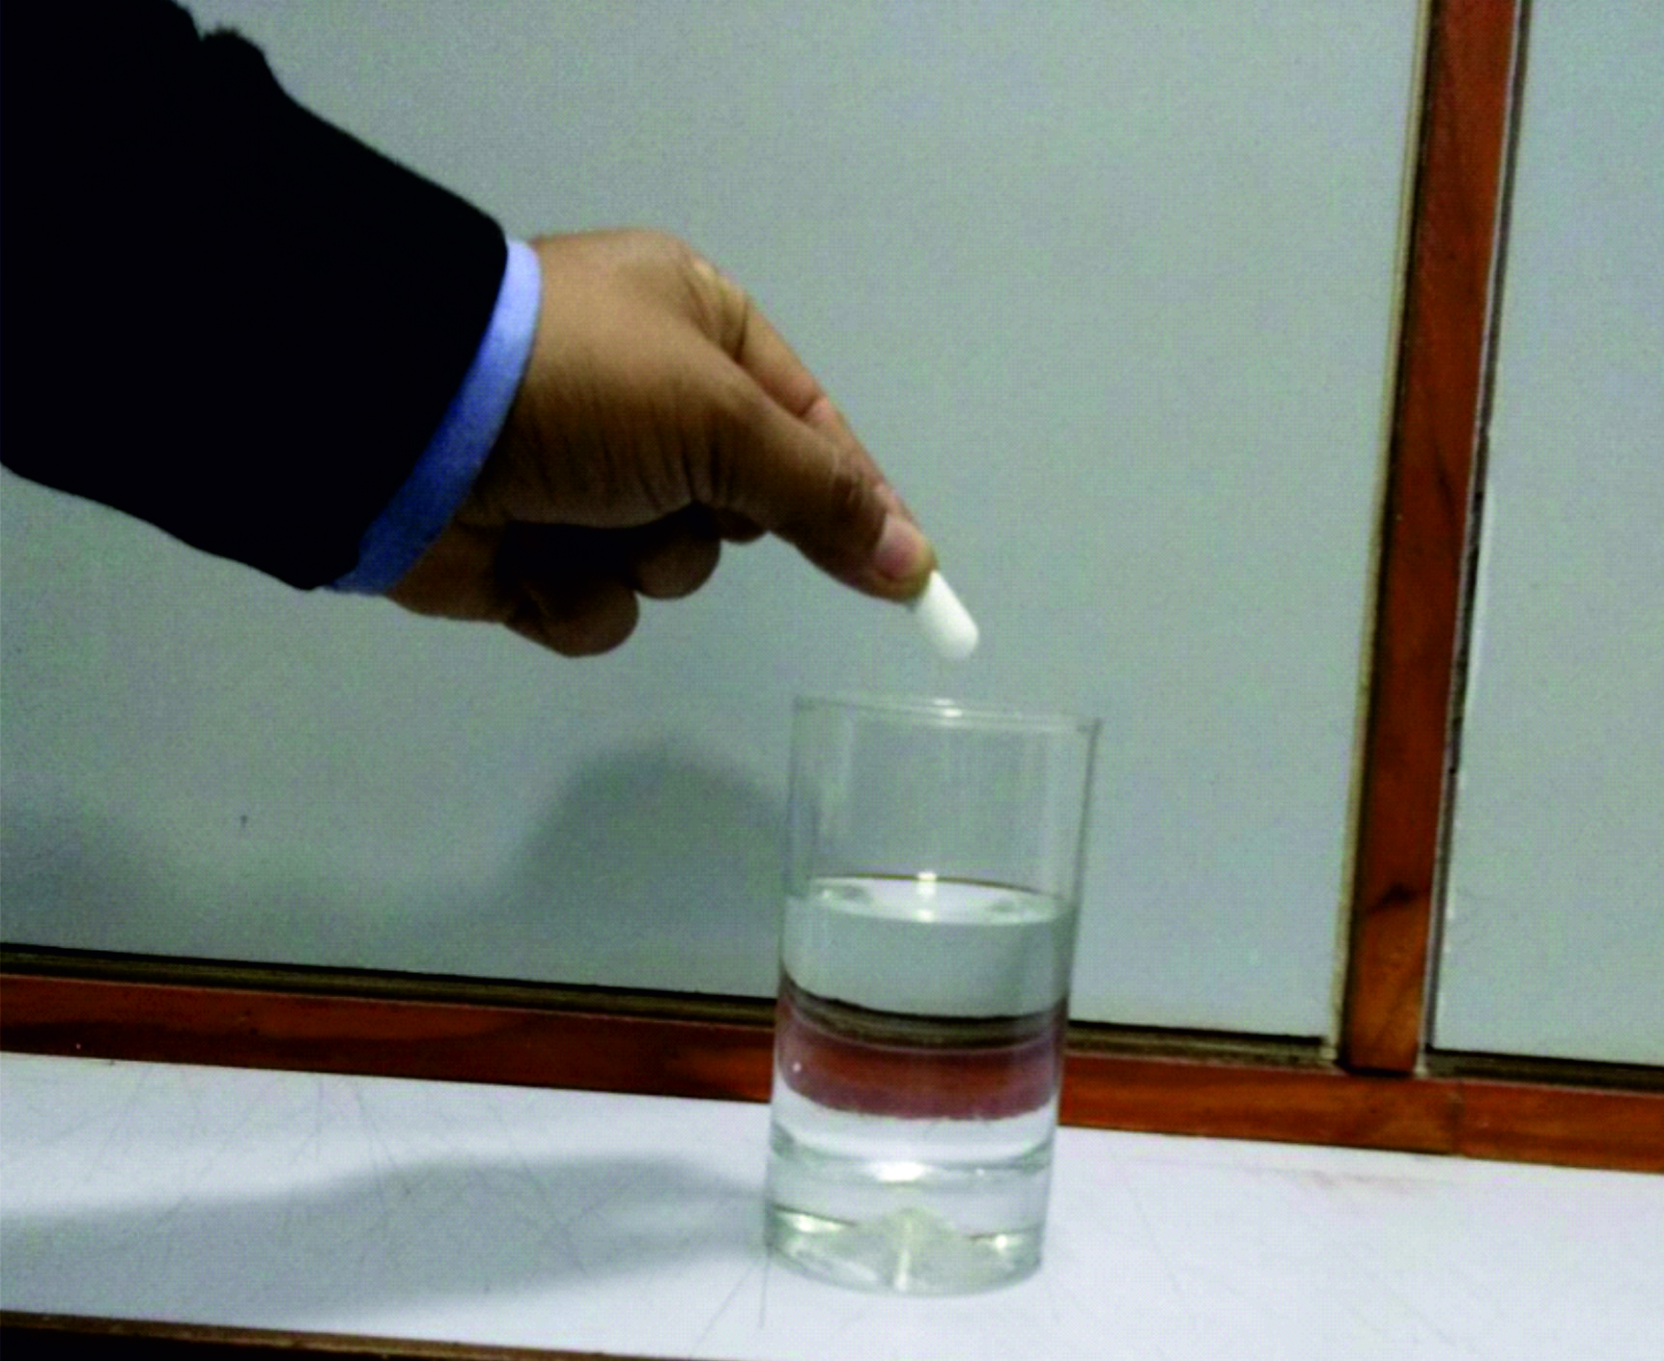
Demo of Keva Calcium
Take 2 glass of fresh water
In one glass add Keva Calcium tablet & in other glass add Calcium tablet of other company
Keva Calcium Tablet
Tablet of other company

Slide 8
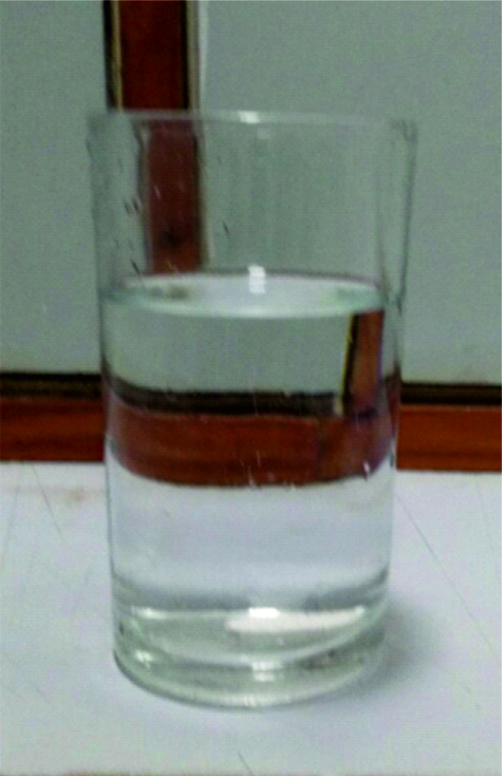
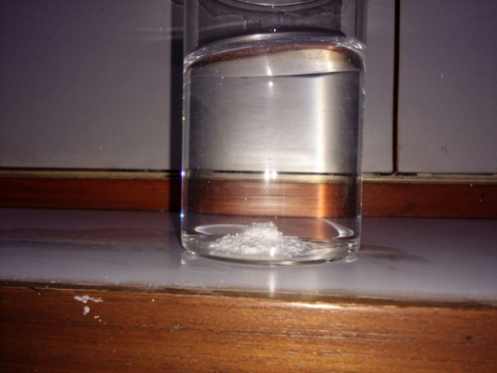
Demo of Keva Calcium
Keva Calcium completely dissolves in water within few seconds showing that it rapidly disintegrates in stomach & quickly absorbed in blood
Tablet in other glass does not dissolve completely & form lumps
Tablet dissolves within few seconds
Tablet does not dissolve completely

Slide 9
Demo of Keva Calcium
This shows that Keva Calcium has better solubility, absorption & bioavailability.

Slide 10
Demo of Keva Calcium
If a tablet dissolves completely in few seconds, means it offers fast and 100% absorption due to the breakdown of large molecules into smaller more easily.
Faster absorption means faster onset of action and instant results.

Slide 11
Contact
Keva Industries Level 2, Prestige Omega, No. 104, EPIP Zone, Whitefield, Bangalore - 560066 (India)
Website : www.kevaind.org

Slide 12
Thank
You

