Slide 1
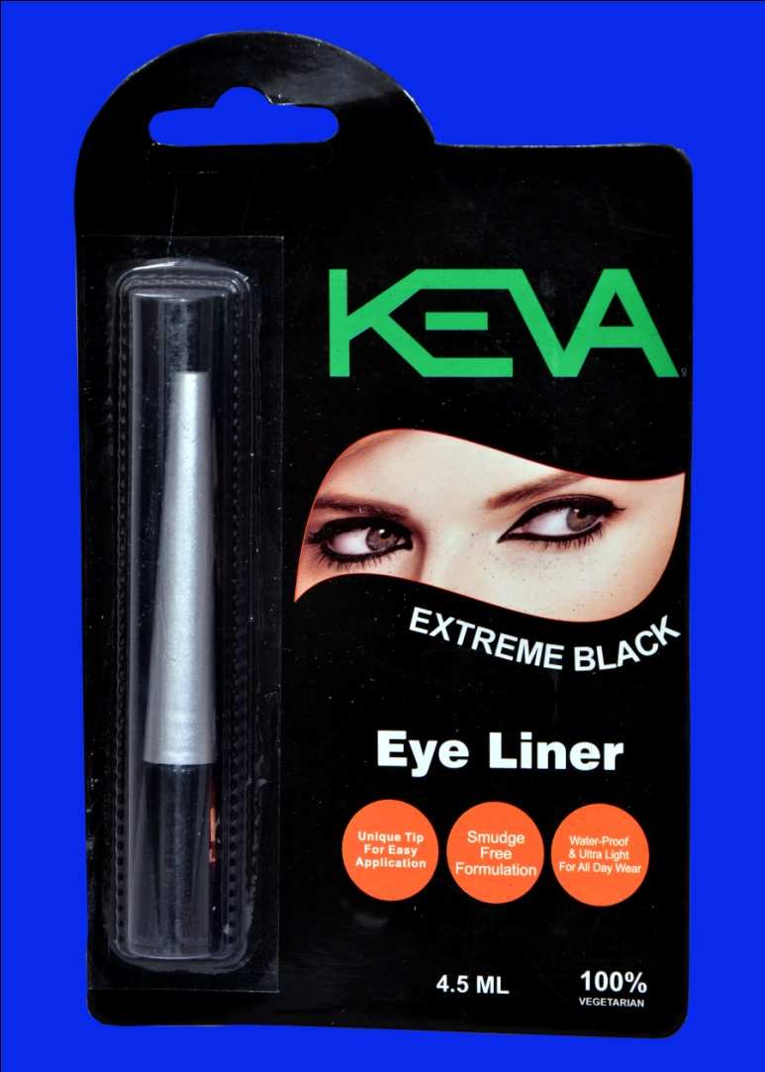
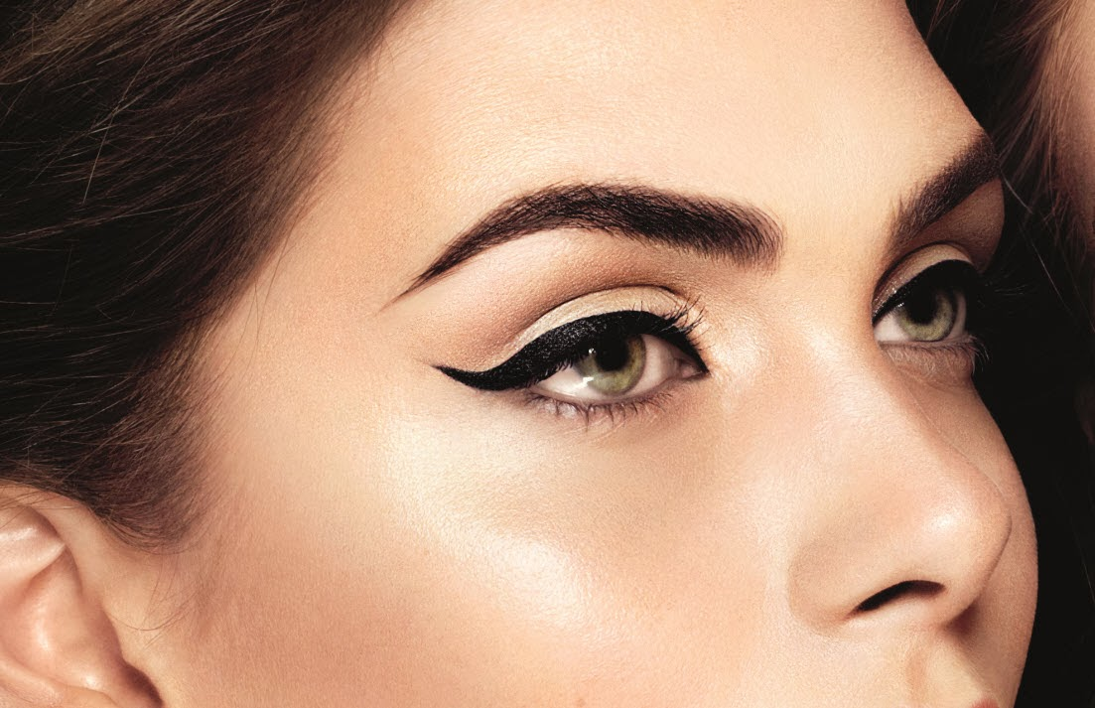
Keva Eye Liner
Demo

Slide 2
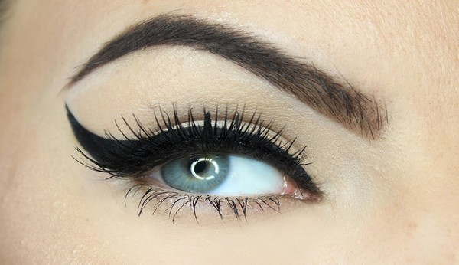
Keva Eye Liner
Define the outline of your eyes with the Keva Eye Liner.

Slide 3
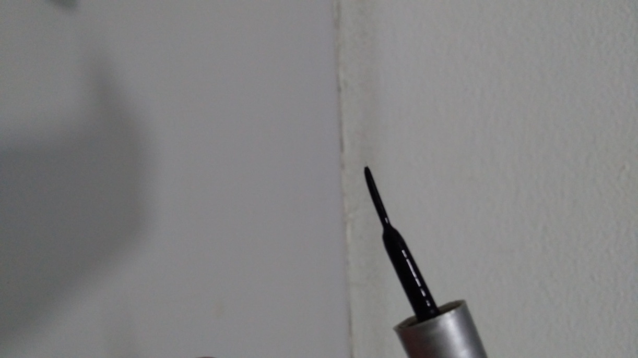
Keva Eye Liner
The smooth brush applies the liner over your eye lids in an even stroke and can be used for various looks you want to create.

Slide 4
Keva Eye Liner
This natural liquid eyeliner contains no animal byproducts, parabens and synthetic fillers thus safe for eyes and does not cause irritation.

Slide 5
Features
Easy to use designed Tip
Smudge Free Formulation
Bold and flawless
Long stay & long shine
Water resistant - fast drying
Ultra Light for all day wear
Long handle for easy grip

Slide 6
Keva Eye Liner
The deep black color of this Eyeliner accentuates your eye makeup and adds a dash of dramatic beauty and glamour to them.

Slide 7
Keva Eye Liner
This eyeliner is endowed with a water-resistant formula that also makes it last longer.

Slide 8
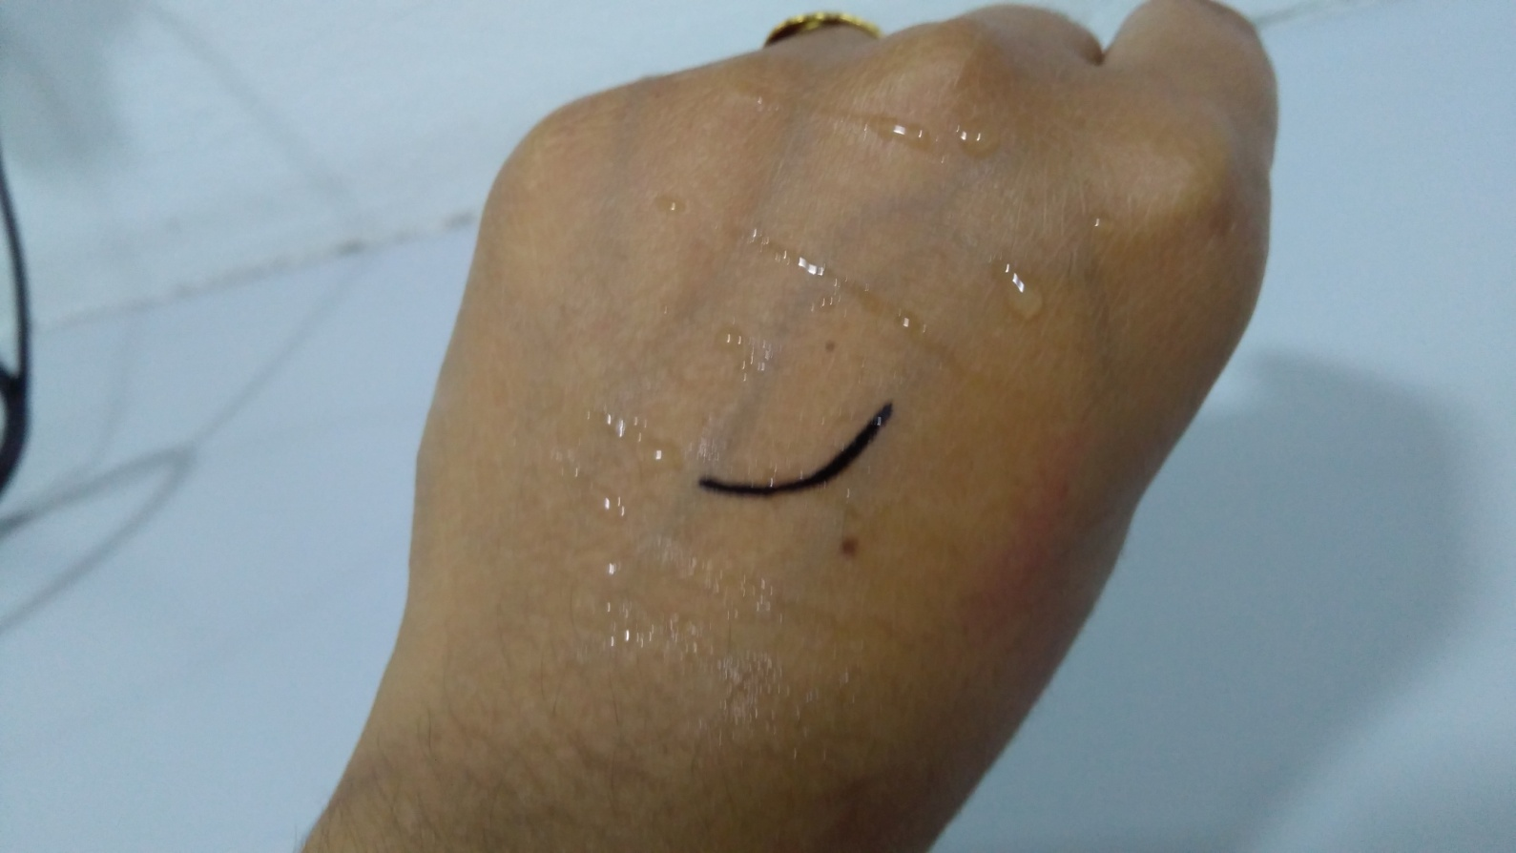
Keva Eye Liner
Water Proof and Smudge Proof
Apply a stroke of Keva Eye Liner on your hand and sprinkle some water on it. Black color will not leach out. This demo shows that it is water proof and smuldge proof.

Slide 9
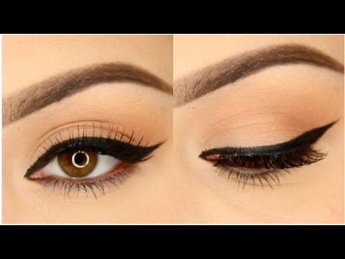
Keva Eye Liner
This rich, intense black liner, makes your look last longer with its smooth application, water proof & instant drying formula.

Slide 10
Contact
Keva Industries Level 2, Prestige Omega, No. 104, EPIP Zone, Whitefield, Bangalore - 560066 (India)
Website : www.kevaind.org

Slide 11
Thank You
This product is not intended to treat, prevent, cure any diseases, please consult your healthcare physician.

