Slide 1
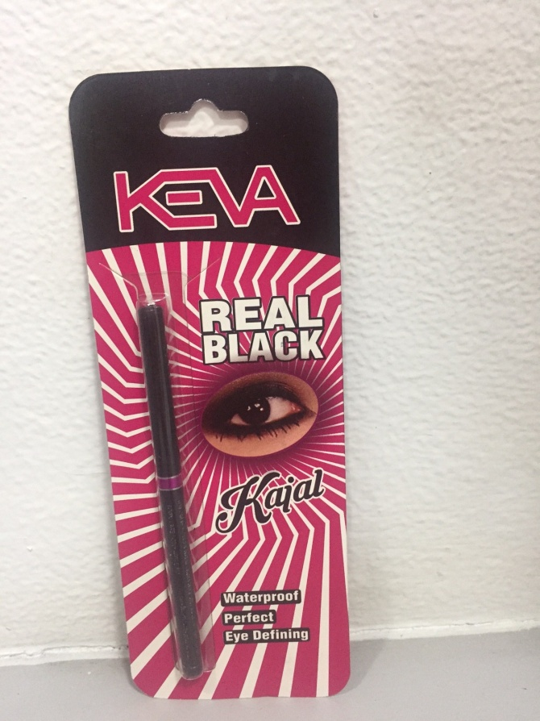
Keva Kajal
Demo

Slide 2
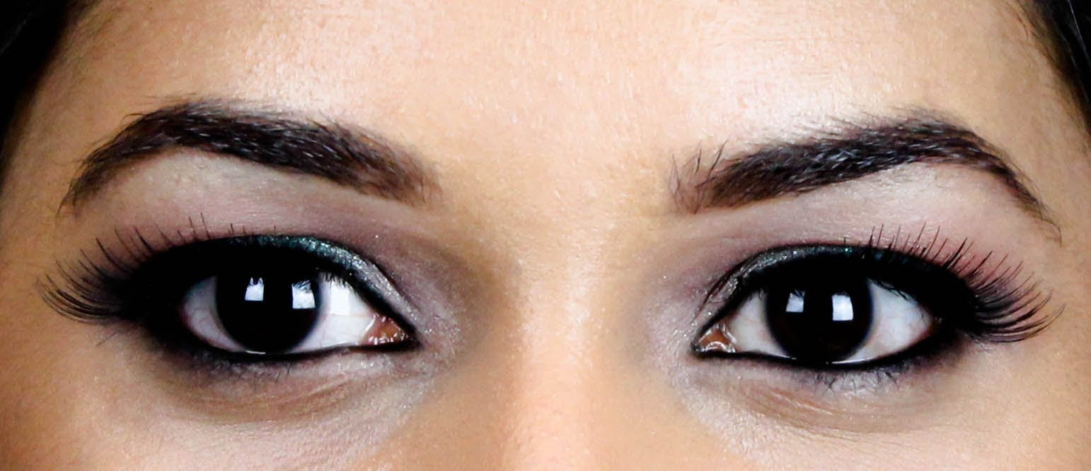
Keva Kajal
Applying Kohl/Kajal is an Indian tradition and has always been in vogue since ancient times. Now Kajal pencils are available which are much easier to use.

Slide 3
Keva Kajal
It is very important to choose an appropriate product for eyes as eyes are the most sensitive part.
Do not use eye pencil that contains harmful ingredients. Application of Kajal that consist of harmful ingredients can produce irritation in your eyes and can also affect your vision.

Slide 4
Eye makeup is incomplete without Kajal, so Keva Industries has launched a new product in beauty care range
Keva Kajal

Slide 5
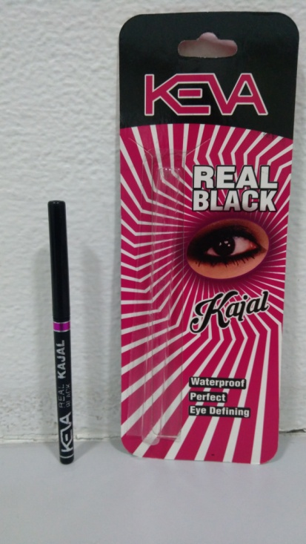
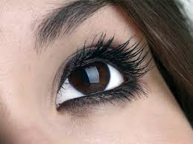
Keva Kajal
Keva Kajal is deep black, smooth, smudge free, water proof Kajal for everyday use.
It has long lasting power for perfect look.

Slide 6
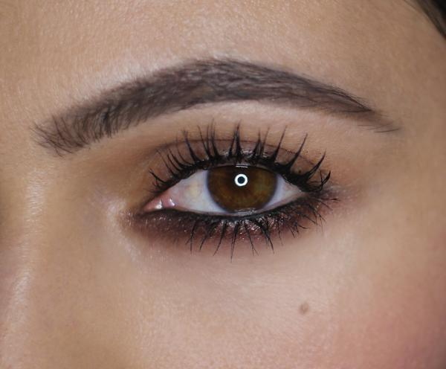
Keva Kajal
It is a natural eye Kajal, consists of natural herbs, vegetable oils and waxes that provide nourishment to your eyes and helps to improve vision.

Slide 7
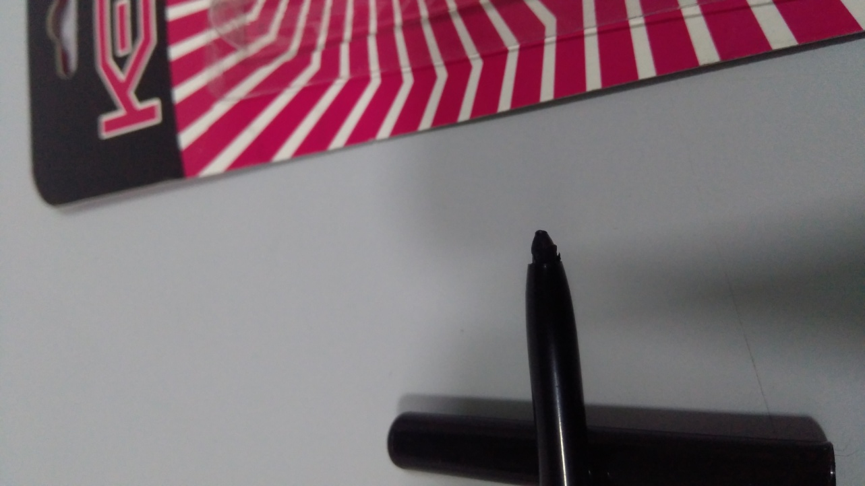
Keva Kajal
This Natural Kajal is available in deep black shade for perfect look.

Slide 8
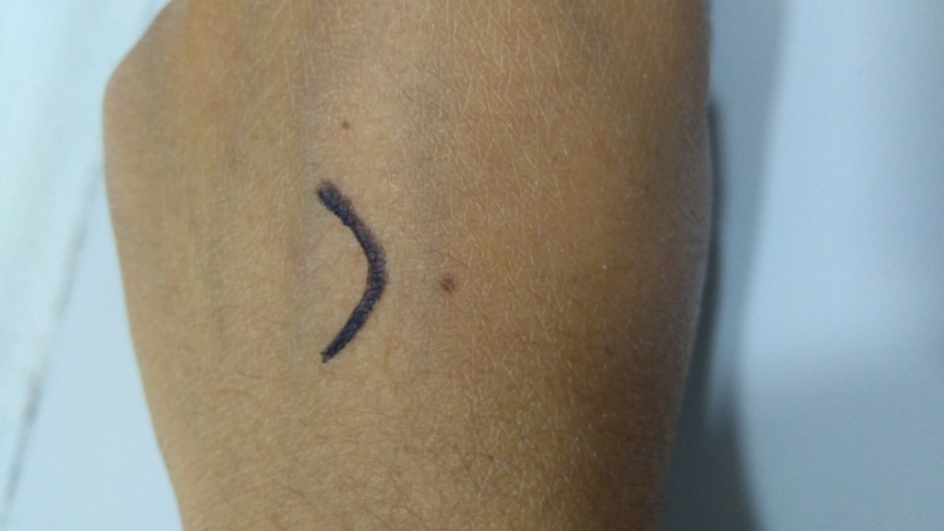
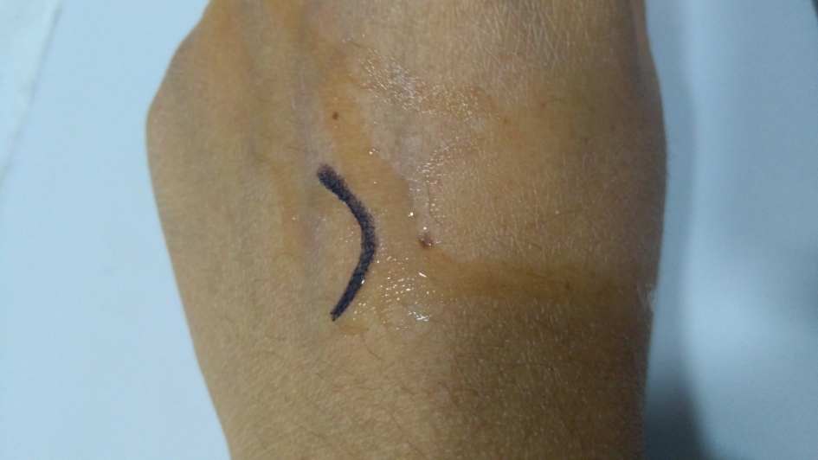
Keva Kajal
Water Proof and Smudge Proof
Apply a stroke of Keva Kajal on your hand and sprinkle some water on it. Black color will not leach out. This demo shows that it is water proof and smuldge proof.

Slide 9
Keva Kajal
You can use this Natural Kajal everyday to make your eyes look beautiful.

Slide 10
Contact
Keva Industries Level 2, Prestige Omega, No. 104, EPIP Zone, Whitefield, Bangalore - 560066 (India)
Website : www.kevaind.org

Slide 11
Thank You
This product is not intended to treat, prevent, cure any diseases, please consult your healthcare physician.

