Slide 1
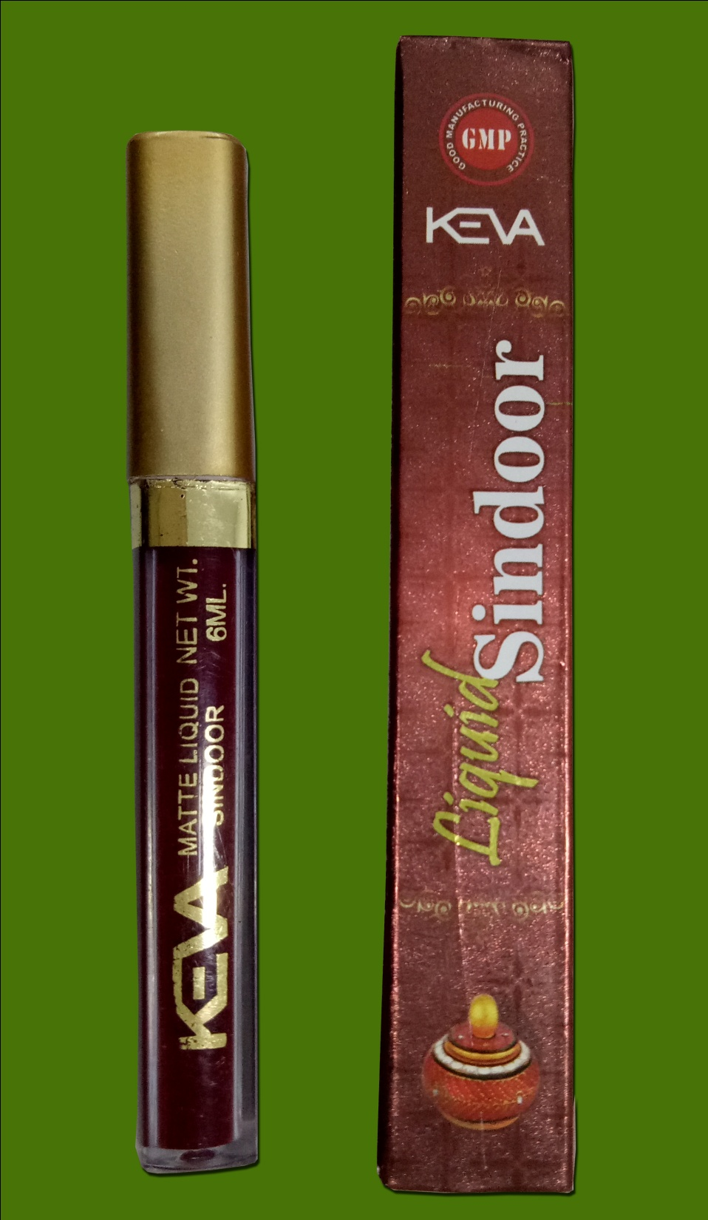
KEVA
Liquid Sindoor
Demo
MRP: Rs. 59/-
Pack Size: 6 ml

Slide 2
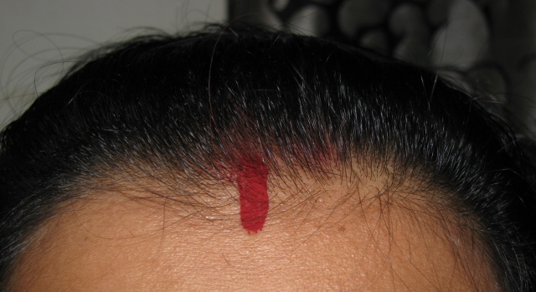
Importance of Sindoor
Sindoor holds lot of importance in Indian society. The tradition of application of sindoor is considered extremely auspicious and is being carried on since centuries.

Slide 3
Importance of Sindoor
Sindoor is also considered to be the symbol of power and female energy of Parvati and Sati.

Slide 4
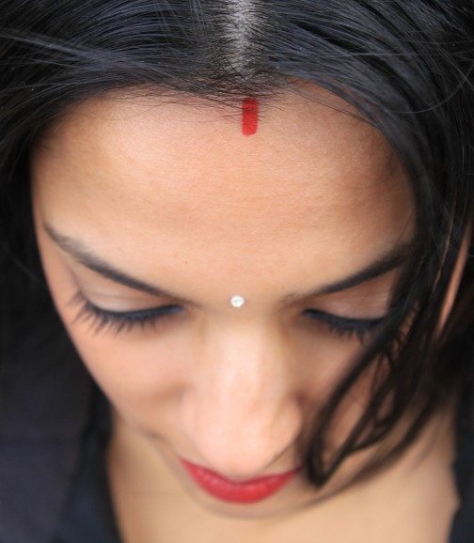
Keva Liquid Sindoor
A ubiquitous part of the married Indian woman’s look, the sindoor not only plays a symbolic role, but it also enhances the beauty of the woman wearing it.

Slide 5
Importance of Sindoor
The application of sindoor is not just a ritual, but a practice which stimulates good health.

Slide 6
Importance of Sindoor
The sindoor is prepared using mercury, turmeric and lime.
Mercury acts as a catalyst that helps to ease stress and strain. It also helps in keeping the brain active and alert. Other than this, mercury also helps in controlling blood pressure, activating sexual drive and libidinal energy.

Slide 7
Keva Industries has launched
KEVA
Liquid Sindoor

Slide 8
Keva Liquid Sindoor
This liquid based sindoor by Keva has a long-lasting, smudge-proof formula to give you good wear and to make it last long.

Slide 9
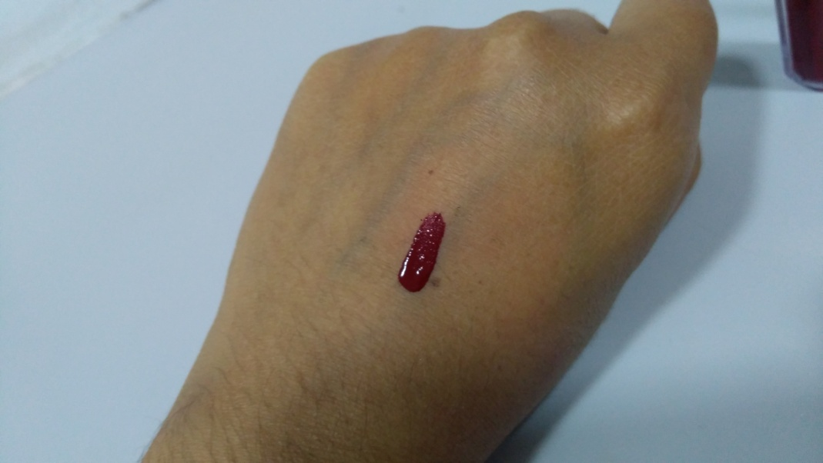
Keva Liquid Sindoor
Complete your traditional Indian look with Keva Liquid Sindoor. It comes in Dark Maroon color with some sparkle particles to enhance your beauty.

Slide 10
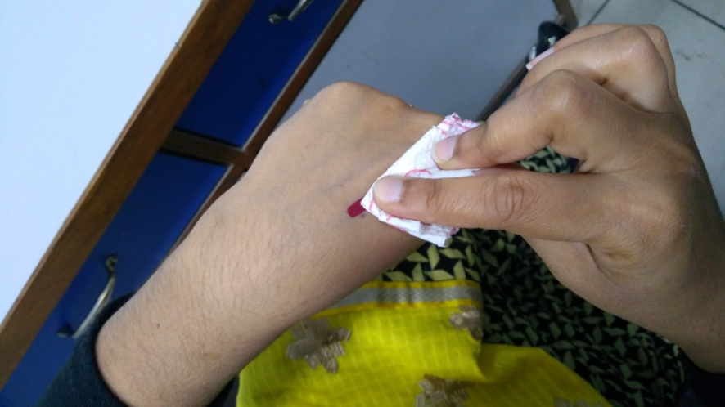
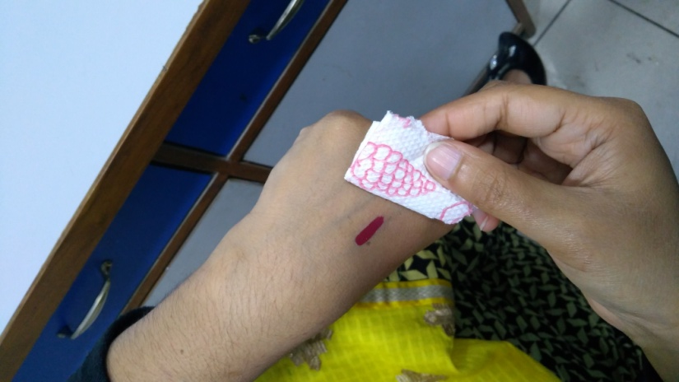
Keva Liquid Sindoor
Quick Drying Formula
Apply a stroke of sindoor on your hand, wait for few seconds and then rub it with the help of napkin, no color stain on the napkin.

Slide 11
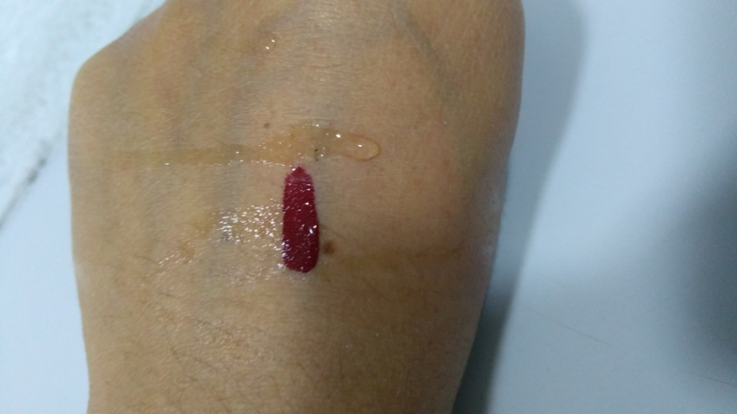
Keva Liquid Sindoor
Water Proof Formula
Apply a stroke of Keva Liquid Sindoor on your hand and sprinkle some water on it. Maroon color will not leach out. This demo shows that it is water proof.

Slide 12
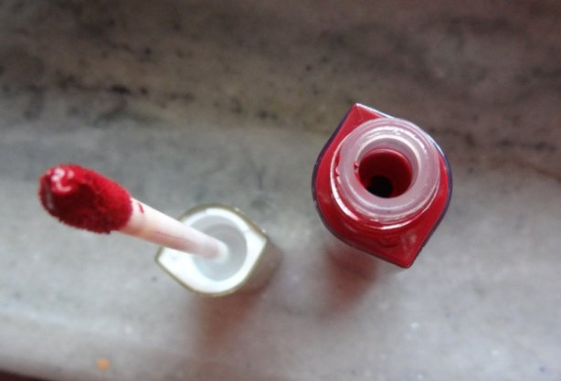
Keva Liquid Sindoor
Get the Keva Liquid Sindoor today and feel like a bride everyday!

Slide 13
Contact
Keva Industries Level 2, Prestige Omega, No. 104, EPIP Zone, Whitefield, Bangalore - 560066 (India)
Website : www.kevaind.org

Slide 14
Thank You
This product is not intended to treat, prevent, cure or diagnose any diseases please consult your healthcare physician.

