Slide 1
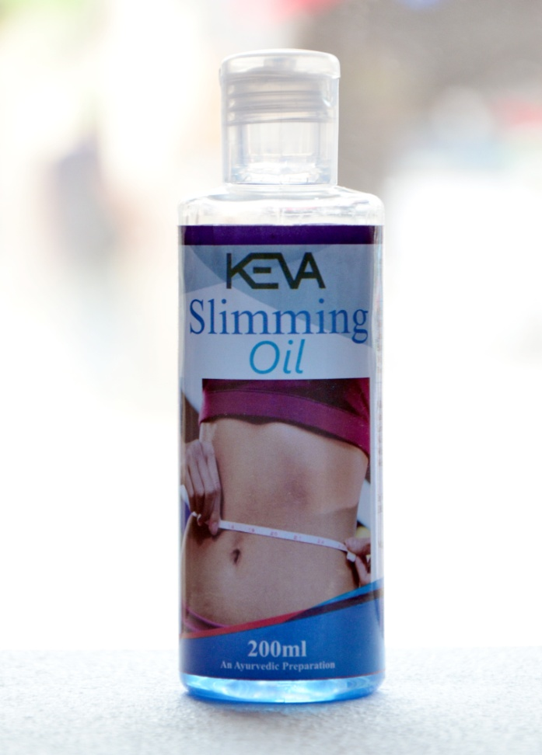
Keva SLIMMING oil
100% Natural Oil, contains herbal ingredients which are primarily known to attack the stomach cellulite
Can help to reduce cellulite, firm skin
and increase skin elasticity
May give you visible results in just few
Days of use, restore body's youthfulness
Moreover this is non-greasy oil, give
smooth skin, increase skin elasticity,
and fight stubborn fat
One can use in Waistline, Neck, Thighs,
Hips, or Upper arms & get firmness

Slide 2
Enriched with herbal ingredients
Asphaltum
Commiphora wightii
Withania Somnifera
C. Arabica
Gymnema sylvestre
Cassia Senna
Lemon Extract
Aloe Barbadensis
Sesamum Indicum Oil

Slide 3
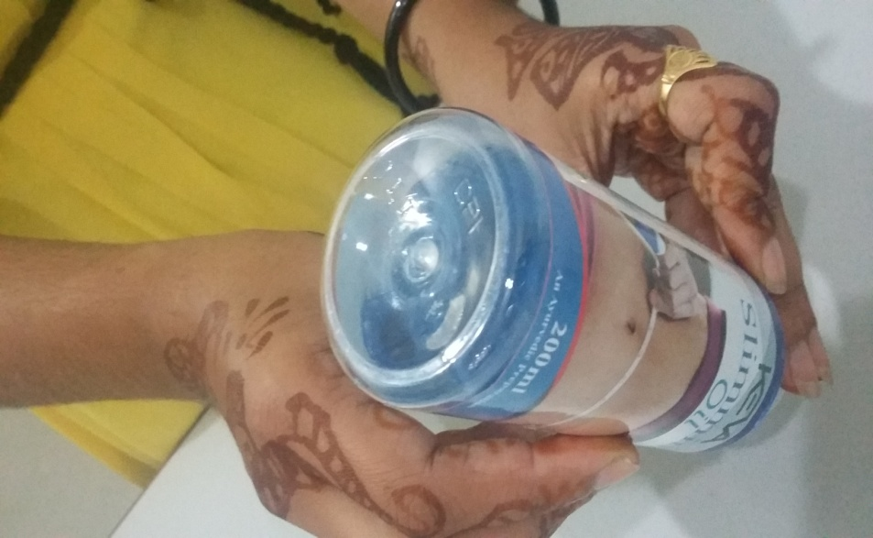
Demo To check PRODUCT quality
Flip Over test
When upend (Flip Over) the oil bottle
The entire content flows towards the bottle top
No residue will be separately visible on bottom part

Slide 4
Demo To check PRODUCT quality
Eye Test
While putting the oil near to the eyes,
The eyes do not feel irritation
There will be no tears in eyes

Slide 5
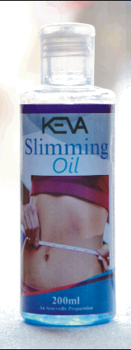
CONCLUSION
Shows that Keva Slimming Oil is of
Best quality
Uniformly and properly mixed
Do not stick to bottom of the bottle
Dot not cause any irritation to the eyes

Slide 6
Note: This is not intended to treat, prevent & cure any diseases.

