Slide 1
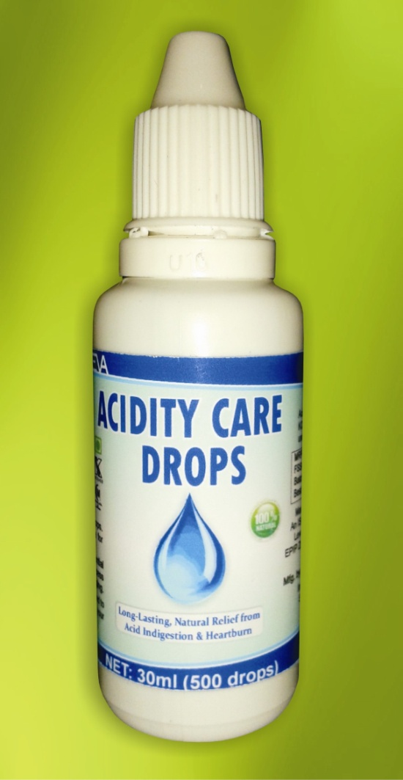
Keva
acidity care drops

Slide 2
Keva ACIDITY CARE drops
100% Natural & Herbal Remedy
Unique blend of essential nutrients
Help naturally neutralize excess
acidity that can cause illness &
premature aging
Maintain & restore the pH value of
body, help to relieve acidity

Slide 3
Highest Quality Product
Each batch of Keva Acidity Care Drops is produced under international GMP regulations, have got internationally acclaimed HALAL & KOSHER Certification

Slide 4
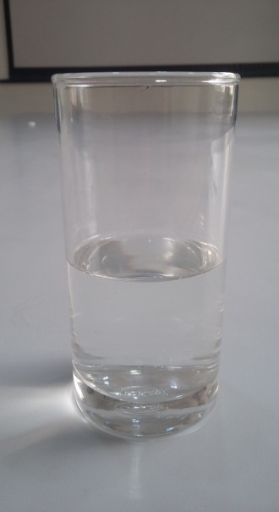
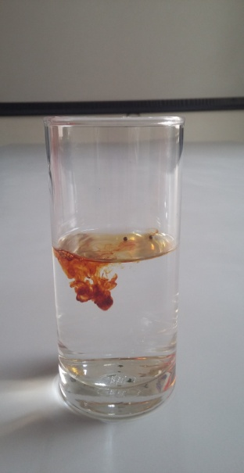
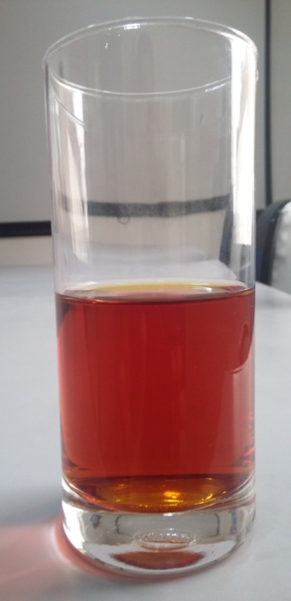
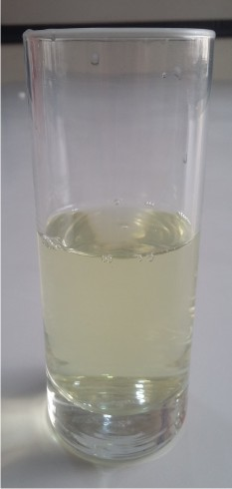
Test to check effectiveness of Acidity care drops
Take glass of fresh water and add few drops of Betadine in it
The color of water changes to red
Then add few drops of Acidity Care Drops in Betadine containing
solution, then red color will disappear and water will come to its
natural color

Slide 5
Conclusion
Shows that Acidity care drops provide
strong anti oxidant protection, protect
stomach cells from free radicals damage
caused by excess acid production
Destroy excess acid in stomach and
prevent from so many acidity related
problems
If used on regular basis, Acidity Care Drops can naturally
Neutralize excess acid and promote gastrointestinal health

