Slide 1
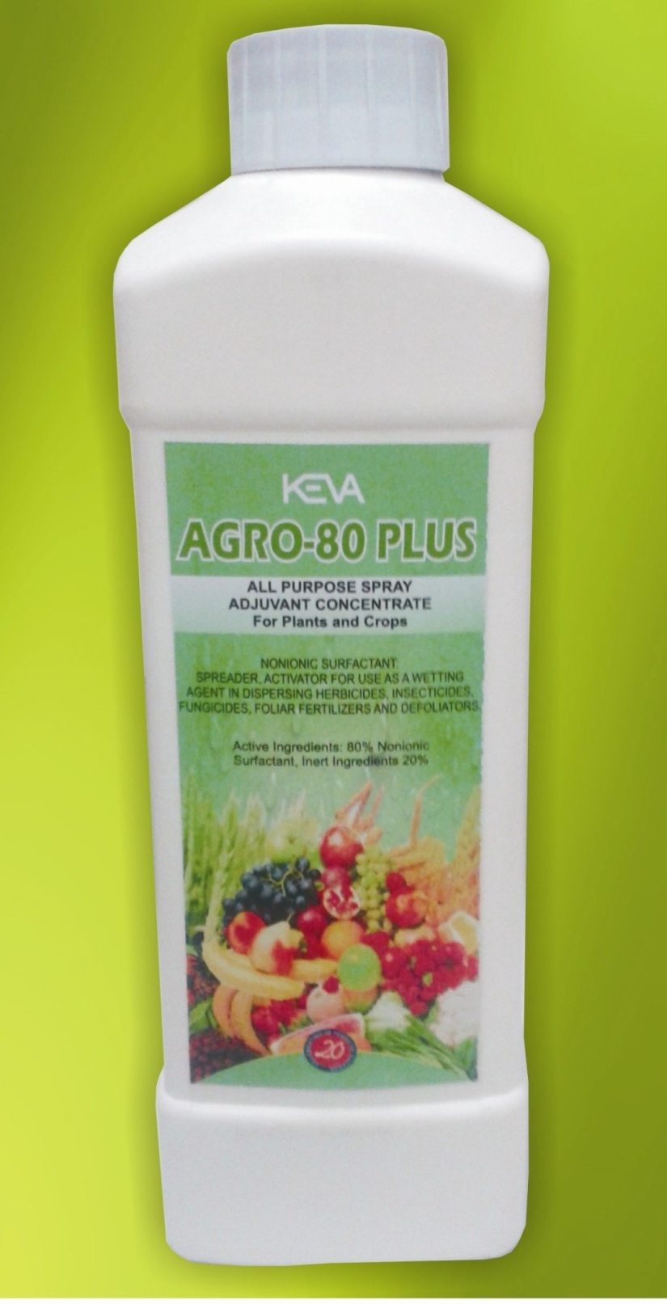
Agro 80 Plus
By Keva Industries

Slide 2
Keva Agro 80 Plus
Formulated by Keva Industries in joint venture with Droi Pharma, USA
Non ionic spray adjuvant
Highly concentrated
All purpose spray
Non toxic
Non corrosive
Biodegradable
Improve effectiveness of pesticides and
fertilizers, increase crop yield

Slide 3
Need of Keva Agro 80 Plus
For a pesticide to be effective, spray droplet must
Spread out uniformly over leaf surface
Penetrate the leaf surface
Pesticides do not effectively penetrate leaf surface due to
Wax or oils present on leaf surface
Surface tension between leaf surface
and spray droplet

Slide 4
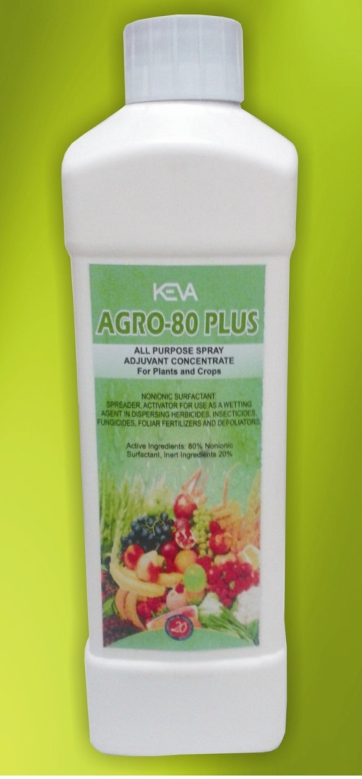
Need of Keva Agro 80 Plus
Mixing Agro 80 Plus with the pesticide solution
Reduce the surface tension
Prevent beading of droplets
Enable uniform coverage of pesticides
Help pesticides to penetrate the surface
of the leaf faster and more evenly
Ultimately, result in a better crop yield

Slide 5
DEMO TO CHECK Agro 80 Plus quality
Drop Test
Mustard Test
Show how well Keva Agro 80 Plus
Reduce surface tension
Increase wettability, spreadability & penetration
power of pesticides, insecticides or fertilizers

Slide 6
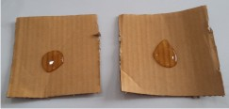
Drop Test
Take 2 pieces of card board
Place one drops of water
on each board
It forms a bead like structure (because of the surface
tension between the surface of board and water droplet)

Slide 7
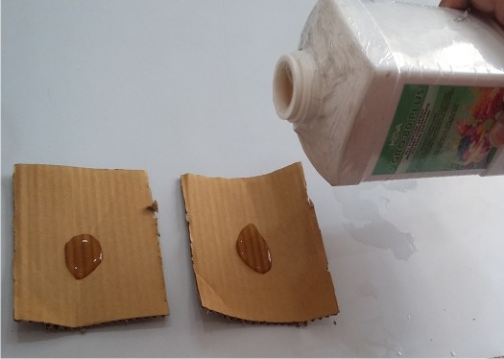
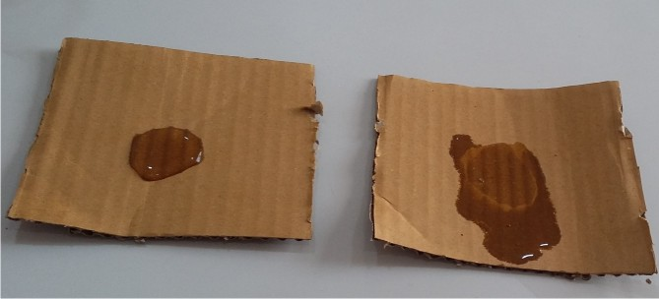
Drop Test
Then place a drop of Keva Agro
80 Plus on this water droplet
Water droplet spread
(as it decreases the surface tension
between the surface of board and
water droplet)

Slide 8
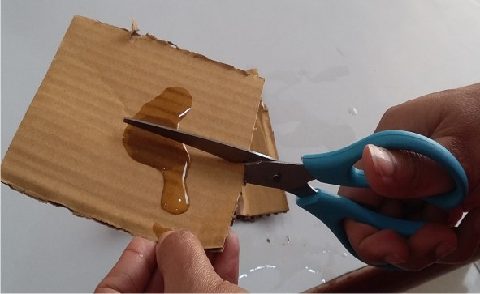
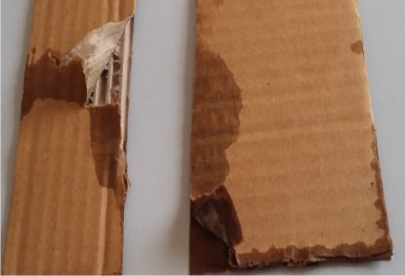
Drop Test
Then cut the board from centre
You can clearly see that water
started spreading
While in 2nd board water has
remained on the same area
only no spreading was noticed there
It shows that Keva Agro 80 Plus increase the penetration power of water or we can say that penetration power of pesticides

Slide 9
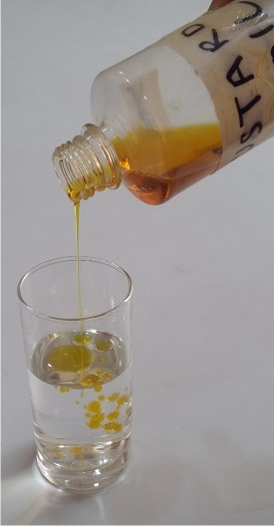
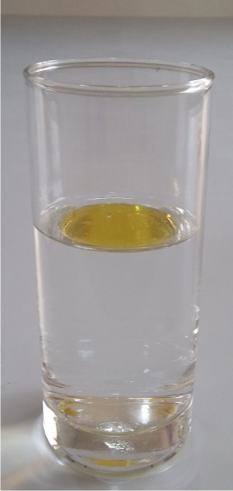
MUSTARD Test
Take one glass of water
Add few drops of mustard oil
It form a bead like structure over the surface of
water

Slide 10
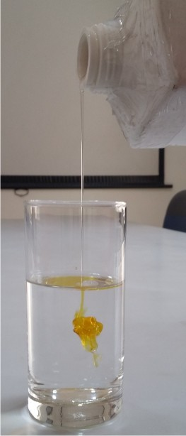
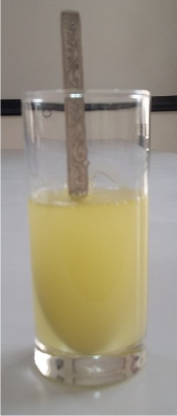
MUSTARD Test
Then add few drops of Keva Agro 80 Plus in it
After adding Agro 80 Plus oil will completely dissolve
in water
It shows that Keva Agro 80 Plus reduce surface tension and promote uniform spreading of pesticides in water

Slide 11
Conclusion
From these two tests it is concluded that Agro 80 Plus increase
Uniform mixing of pesticides, insecticides, fungicides, foliar fertilizers and defoliators with water
Uniform spreading on leaf surface

Slide 12
Conclusion
Also it is concluded that Agro 80 Plus can help -
Even penetration of pesticides, insecticides, fungicides, foliar fertilizers and defoliators even help in irrigation when mixing with water
Performance of pesticides, insecticides, fungicides, foliar fertilizers and defoliators
Hence Better crop yield

Slide 13
Vastly superior to any competing
product in the market

