Slide 1
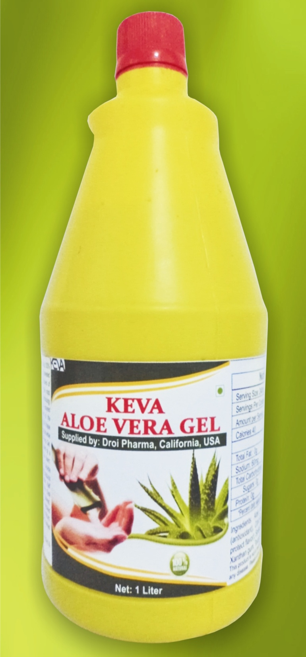
Keva
Aloe Vera gel

Slide 2
Nature’s Original Health Drink
Scientifically proved
No side effects
No Artificial Color
No Artificial Flavor
100% Sugar free
No added water
Not made from powder
No Thickeners
Oxidation-free packaged
100% stabilized Aloe Vera Gel
Cold temperature processed
Specially designed to enhance proper functioning in the body

Slide 3
Extracted From Freshly Harvested Mature leaves
Produced from fresh and matured Aloe Vera leaves
Obtained from most nutritionally rich Aloe vera
species, Aloe barbadensis miller
Aloe vera is grown under strict supervision of eminent scientists without the use of any pesticides or insecticides to deliver highest quality product

Slide 4
Highest Quality product
100% natural, no side effects
Produced under International
GMP regulations
HALAL and KOSHER Certified
H

Slide 5
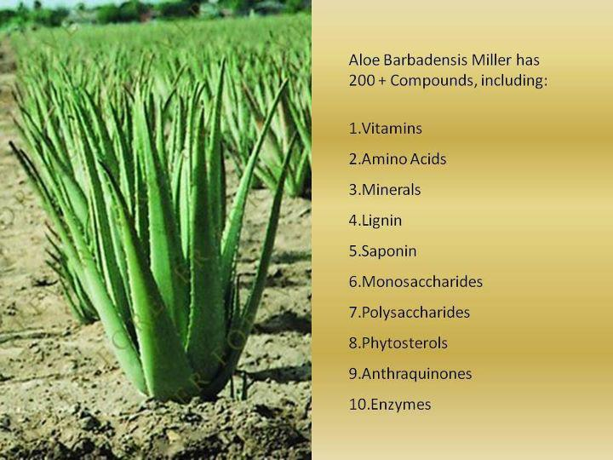
What makes it so effective
Highly nutritious
More fibrous
Loaded with so many
health enhancing
nutrients
Contains more than
200 components
Contains 20 minerals
12 vitamins
8 required amino acids
14 secondary amino acids
Important enzymes

Slide 6
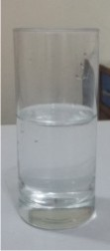
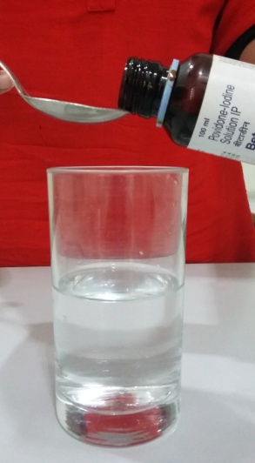
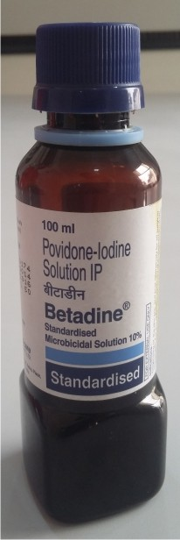
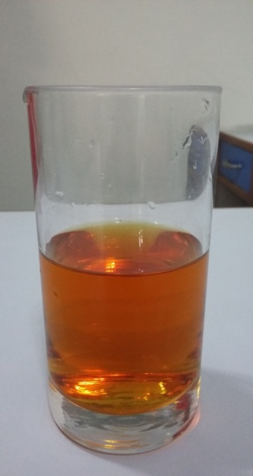
Live DEMO TO CHECK Product Quality: Betadine test
Take a glass of fresh water
Add 1 tablespoon of Betadine
which leads to change the color
of water to red, which shows the
presence of harmful chemical

Slide 7
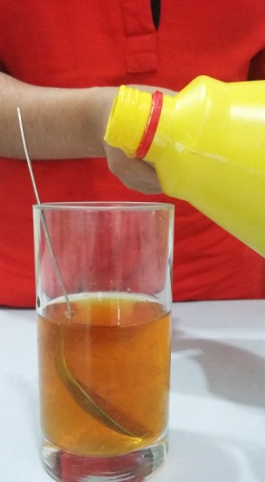
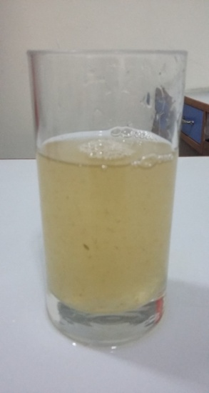
Live DEMO TO CHECK Product Quality: Betadine test
When we add around 15-20ml Keva Aloe Vera Gel in Betadine mixed water then again water comes to its normal transparent appearance

Slide 8
Conclusion
Shows that Keva Aloe Vera Gel is 100%
stabilized gel which protects it from
oxidation, and seals in it the natural
potency
Provides strong Anti Oxidant effects
By taking this product on regular basis,
you can naturally detoxify your body
from disease causing harmful free radicals
And in future there will be fewer chances
of problems in the body
While many other products are not stabilized and chances
of oxidation are there in such products

Slide 9
Note: This is not intended to treat, prevent & cure any diseases. Please consult your health professional.

