Slide 1
Keva Industries
brings first time in India
Keva Ancient Mineral Drops
Formulated in Europe

Slide 2
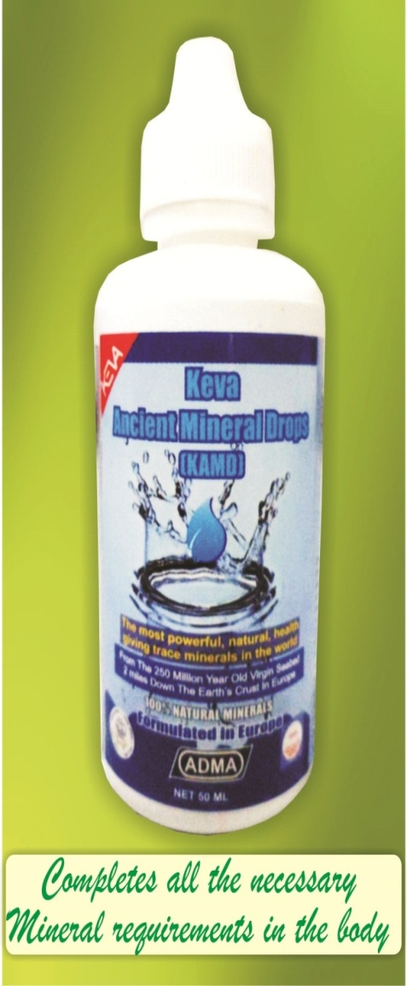
Keva Ancient Mineral Drops
Excellent & Purest product of
Natural Ionic Trace Minerals
in the world
Obtained from the 250 million
year old virgin seabed 2 miles
down the earth's crust in Europe

Slide 3
DEMO TO CHECK KAMD quality
Bulb Test: Show how well different minerals
of KAMD break down into ionic solution in
water
Muscle Test: Show KAMD lead
to an instant flow of energy in
the body, increase in muscle
strength

Slide 4
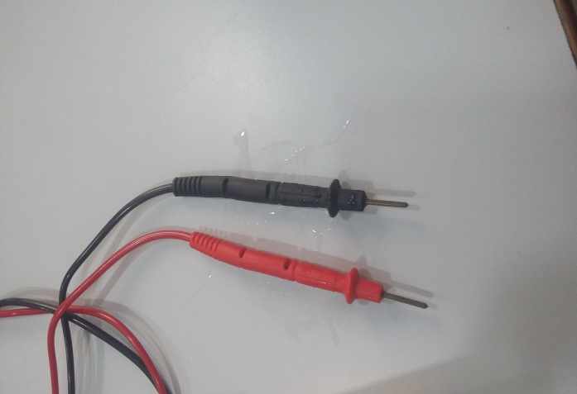
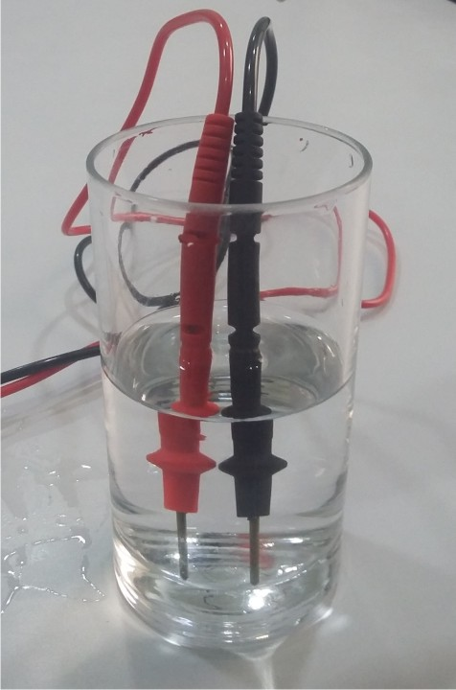
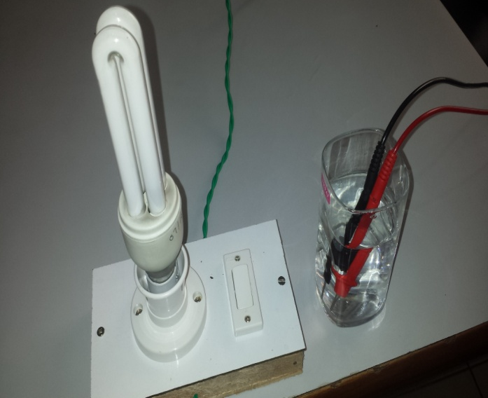
KAMD - Bulb Test
Take one broken circuit that
is connected to two probes
Then insert into mineral water,
but cannot close the circuit
The light bulb does
not light up

Slide 5
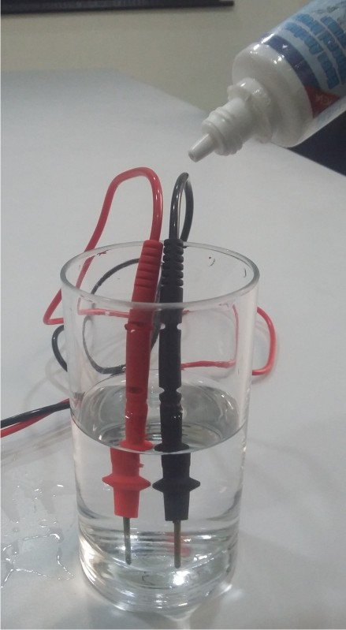
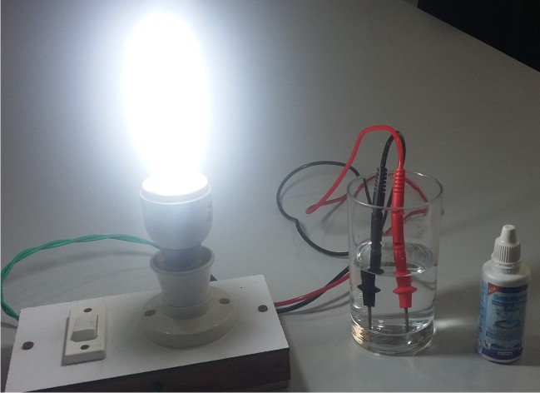
KAMD - Bulb Test
When Few Drops of KAMD are put in the water, it will connect the circuit & light the bulb

Slide 6
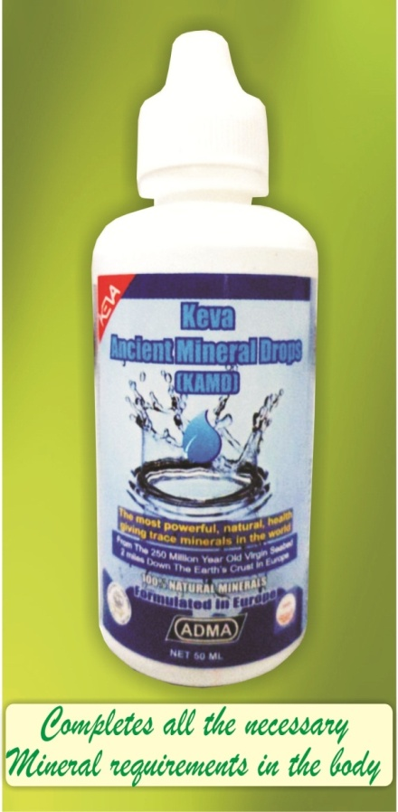
Conclusion of Bulb Test
Explains the nature of minerals in KAMD is ionic & concentrated
If after putting mineral drops in the
simple purified water, the light bulb
do not light up then the minerals are
not in ionic form & break down in
the water. So cannot close the circuit
After putting few drops of KAMD,
you will see circuit is closing enough
to light the bulb & showing the
ionic feature of Minerals

Slide 7
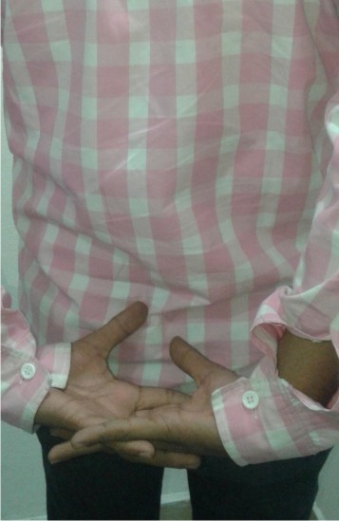
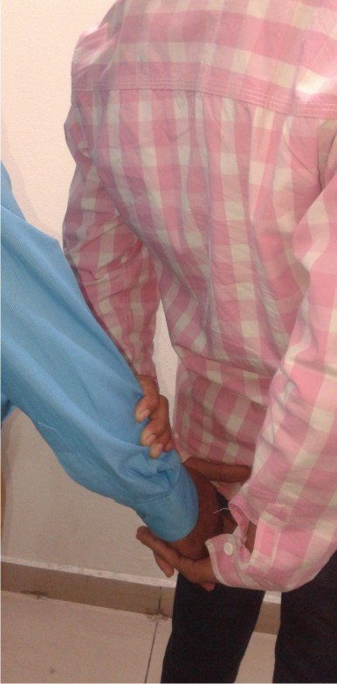
KAMD - muscle Test
Take both hands on back side
& make a tight grip of them
Ask someone to push
down your gripped
hands while you resist
Your hands will go in downward
direction

Slide 8
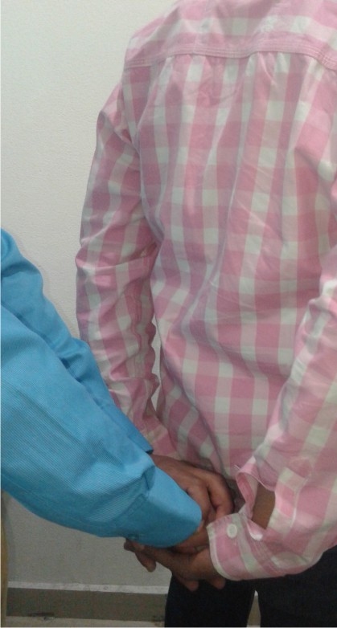
KAMD - muscle Test
Then relax & come back to your normal
position
Take 5-6 drops of KAMD below your
tongue & keep them for 30 sec & swallow
Again repeat the same activity
You will notice the hands go
less down in comparison to
previous due to increase in
strength

Slide 9
Conclusion of MUSCLE Test
Explains the instant inflow of energy in your body after taking KAMD
KAMD lead to an instant inflow
of energy in the body
Help to increase in muscle
strength
If you take this on regular bases then you will notice a big difference in your overall health!

Slide 10
KAMD is the perfect solution for replenishing your body with the nutrients you need to maintain optimum health
Note: This is not intended to treat, prevent & cure any diseases. Please consult your health professional.

