Slide 1
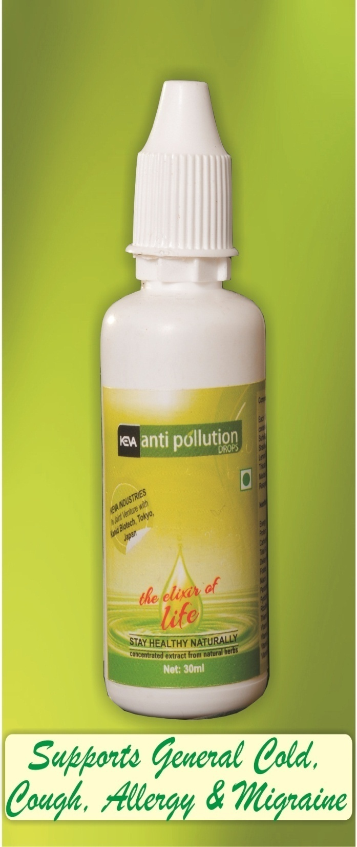
ANTIPOLLUTION DROPS
By Keva Industries

Slide 2
Keva Antipollution drops
100% Natural & Herbal Remedy
Concentrated Extract from Japanese
Natural Herbs
‘Elixir of Life’, promote longevity
Loaded with Anti-cold, cough, fever, Anti-Bacterial, Anti-Infective, Immuno Modulator, Anti-Microbial Properties

Slide 3
DEMO TO CHECK Antipollution Drops quality
Betadine test
Show how well Keva Antipollution drops prevent us from harmful free radicals produced in our body due to unhealthy diet, sedentary lifestyle or pollution

Slide 4
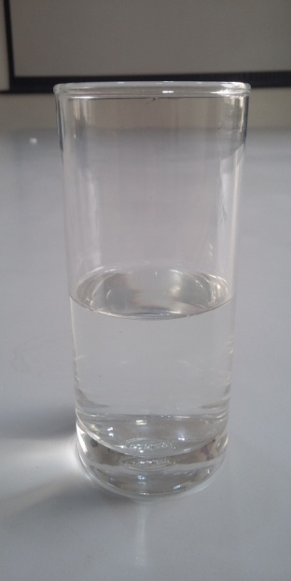
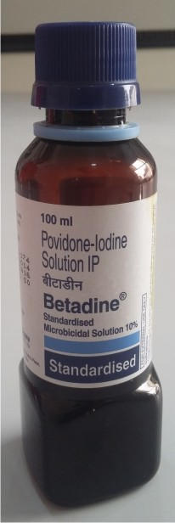
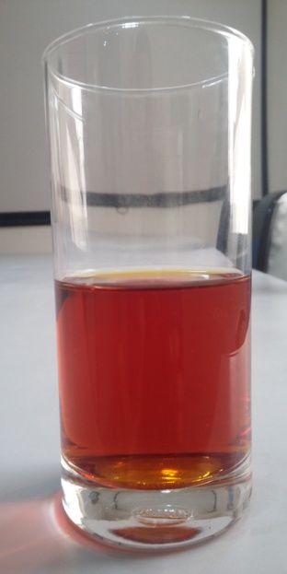
Betadine Test
Take glass of fresh water
Add 1 tablespoon of Betadine, color of water changes to red
+
Change in color of water shows the presence of harmful chemical and thus creates harmful free radicals in body if we go for any chemical based medicinal treatments during any illness

Slide 5
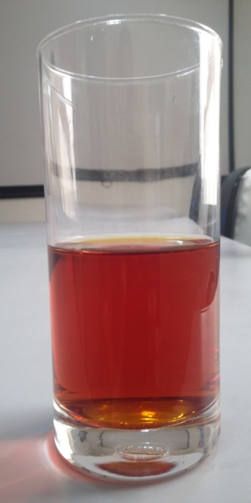
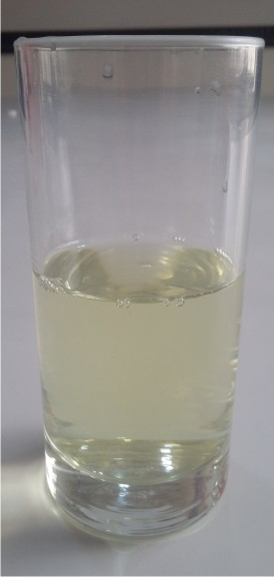
Betadine Test
Add around 10ml Anti Pollution Drops in that Betadine
containing water then again the water comes to its normal
transparent appearance

Slide 6
Conclusion
It shows that Antipollution drops provide strong Anti
Oxidant effects
By taking this product on regular basis, you can naturally
detoxify your body from disease causing harmful free
radicals
And in future there will be fewer chances of problems in
the body

