Slide 1
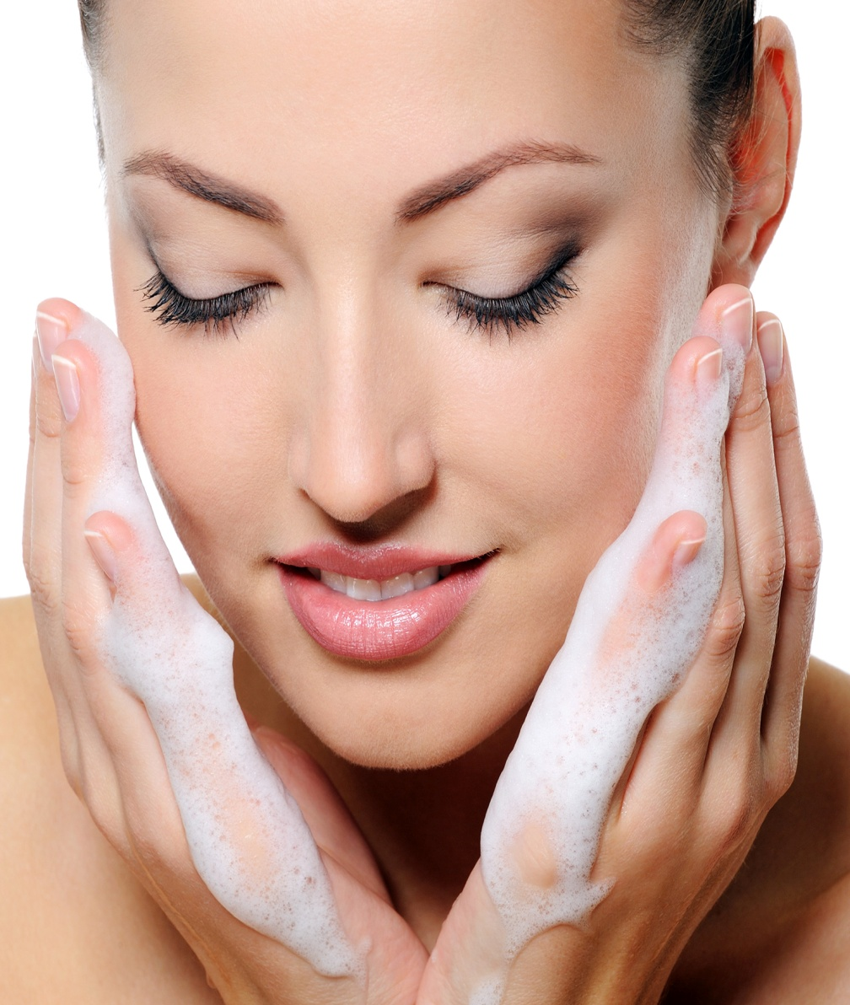
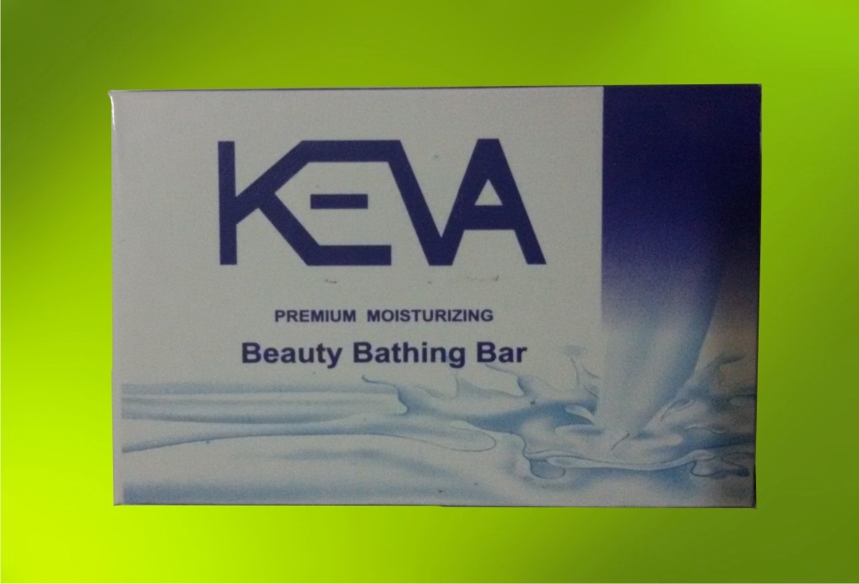
Keva
BEAUTY SOAP
All- Natural Botanical formula

Slide 2
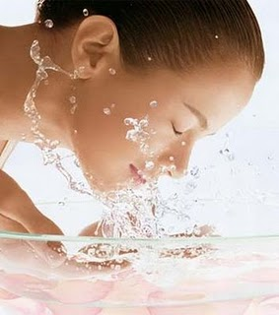
Keva BEAUTY SOAP
Enriched with natural glycerin & long
lasting results of herb oil leaves your
skin clean, refreshed, and naturally
moisturized
With its skin vitalizing property &
natural fragrance, provides freshness
throughout the day
Improves the suppleness & flawlessness of the skin
Non drying formula and will not leave skin dry or itchy
Rinses off easily; leaves no sticky film on your skin

Slide 3
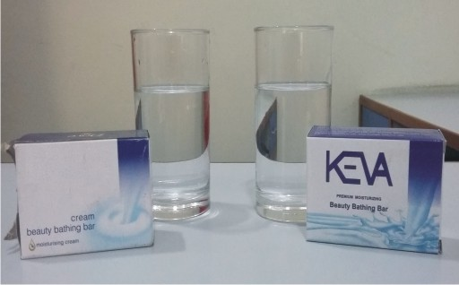
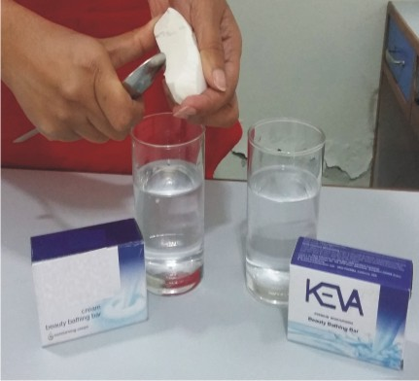
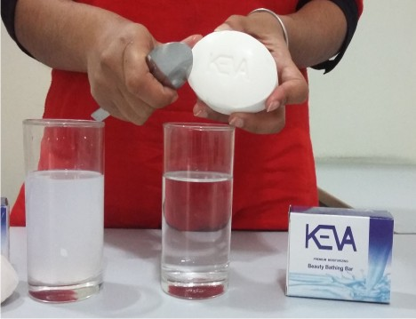
Betadine test to check product quality
Take 2 glasses of fresh water
Add some pieces of Keva Beauty soap in
one glass and other good quality grade 1
soap in another glass
Stir for few minutes so that soap can
dissolve properly

Slide 4
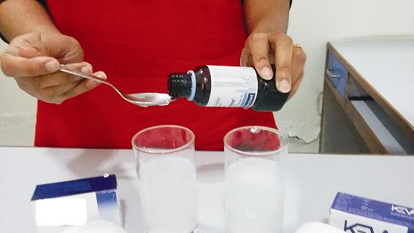
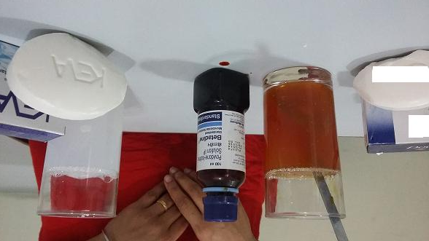
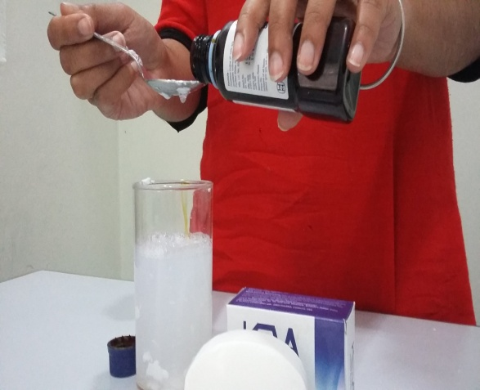
Live demo test
Add 1 tablespoon of Betadine in both
the glasses
Color of soap solution changes from
milky to red which shows the presence
of harmful toxins

Slide 5
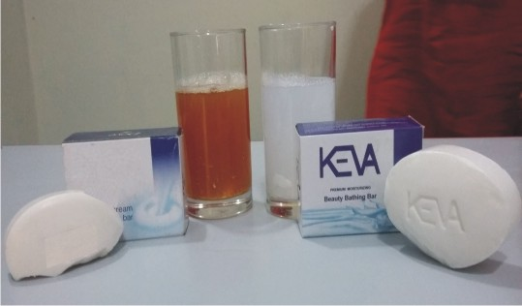
Live demo test
Solution containing Keva Beauty soap again comes to
its normal transparency (milky color) as compared to another
solution containing Dove Soap (remains red in color)
Shows that Keva Beauty soap can effectively prevent our skin from harmful toxins, dirt, chemicals, pollution etc

Slide 6
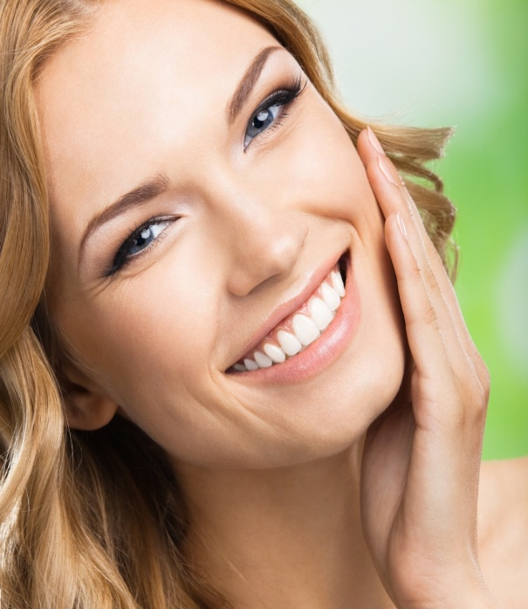
conclusion
Our skin is bombarded daily with foreign
influences such as scorching sun, drying
winds, biting cold weather, bacteria, dirt
Keva Beauty Soap helps in preserving
the health of skin by disinfecting it
from harmful toxins, bacteria and dirt
If we use Keva Beauty Soap on regular basis then it will naturally dispose of the toxins and in future there will be fewer chances of skin related problems

Slide 7
Keva Beauty Soap
You can also do the live demo to show the product efficacy and help you to prove how this product is better than other products available in the market to all your prospective & customers

Slide 8
Note: This is not intended to treat, prevent & cure any diseases. Please consult your health professional.

