Slide 1
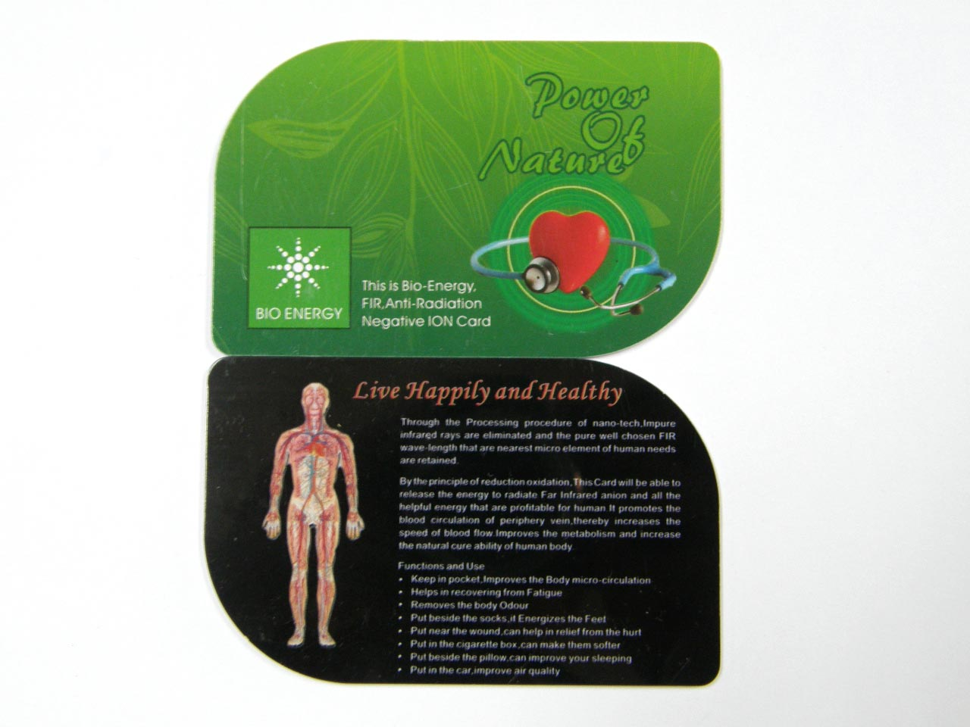
Bioenergy card
By Keva Industries

Slide 2
Bioenergy Nano card
Bio Energy Card consist of Far infrared Ray (FIR), prepared by a unique bio ceramic powder
Created with higher negative ions to heal all parts of the human body
Can also improve the blood circulation in the human body cells which simultaneously improve the energy flow in the human body

Slide 3
NEED OF BIOENERGY CARD
Bio Energy card is considered as an alternative medicine, which is based on a theory that all the illness is caused by disturbance in the flow of energy in the human body
Can maintain the flow of energy
Can improve blood circulation
May prevent from different
diseases

Slide 4
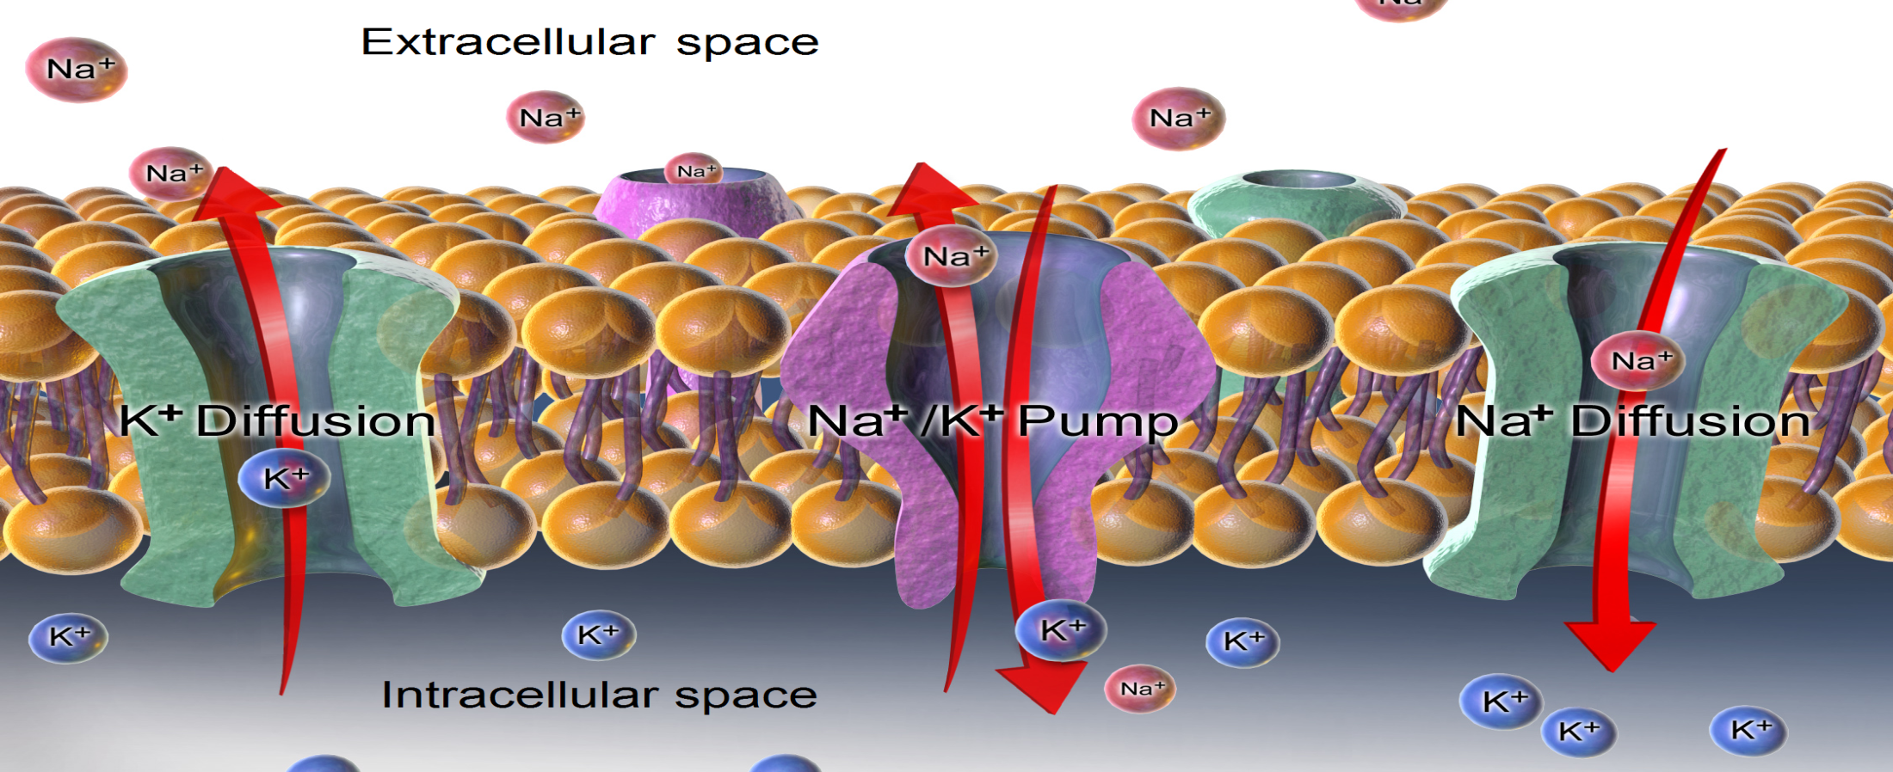
Bioenergy Nano card: Wonderful Product
Can promote exchange of ions inside & outside the cell membrane & keep cell's activity

Slide 5
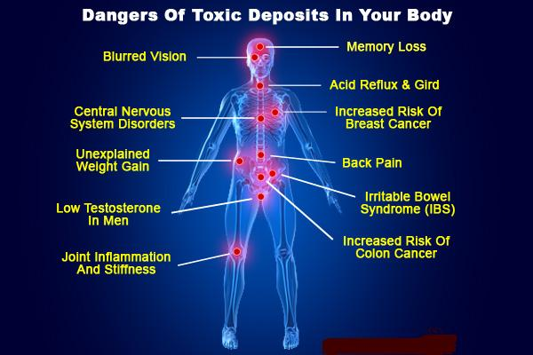
Detox Body Naturally
Can promote cell metabolism & excrete hazardous waste & toxic substances from body

Slide 6
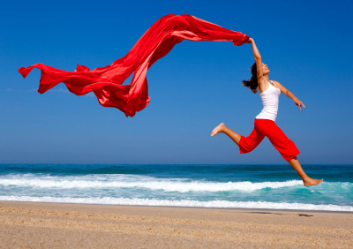
Boost Energy
Can boost energy & stamina
Can resume fatigue as it eliminates illness factors
& quickly recover physical strength

Slide 7
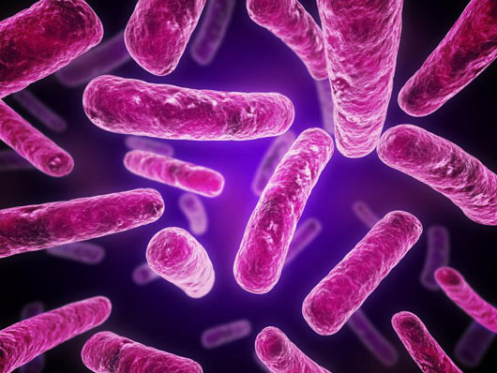
Enhance resistance
Can strengthen the resistance capacity to disease by
Stabilizing emotion
Increasing number of antibodies
Boosting leukin's phagocytic
function to the bacteria

Slide 8
Restrain tumor growth
Can restrain tumor cell growth by influencing the composition & distribution of charged particles in blood & increase cell's activity

Slide 9
SHIELD EMF radiations
EMF is also called "invisible killer", can cause the function obstacles of central nervous system which can cause many symptoms, such as headache, dizziness, insomnia, hair loss etc & for severe case may cause cancer
Bioenergy Card can absorb & shield electromagnetic radiation as well as improve allergic physique

Slide 10
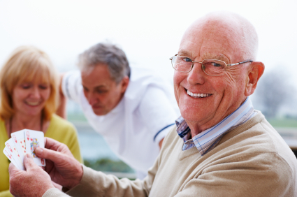
Boost brain function
Can excite nerves
Can enhance brain activity
Can improve work efficiency
May improve memory &
concentration
May improve sleep quality

Slide 11
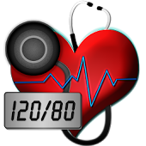
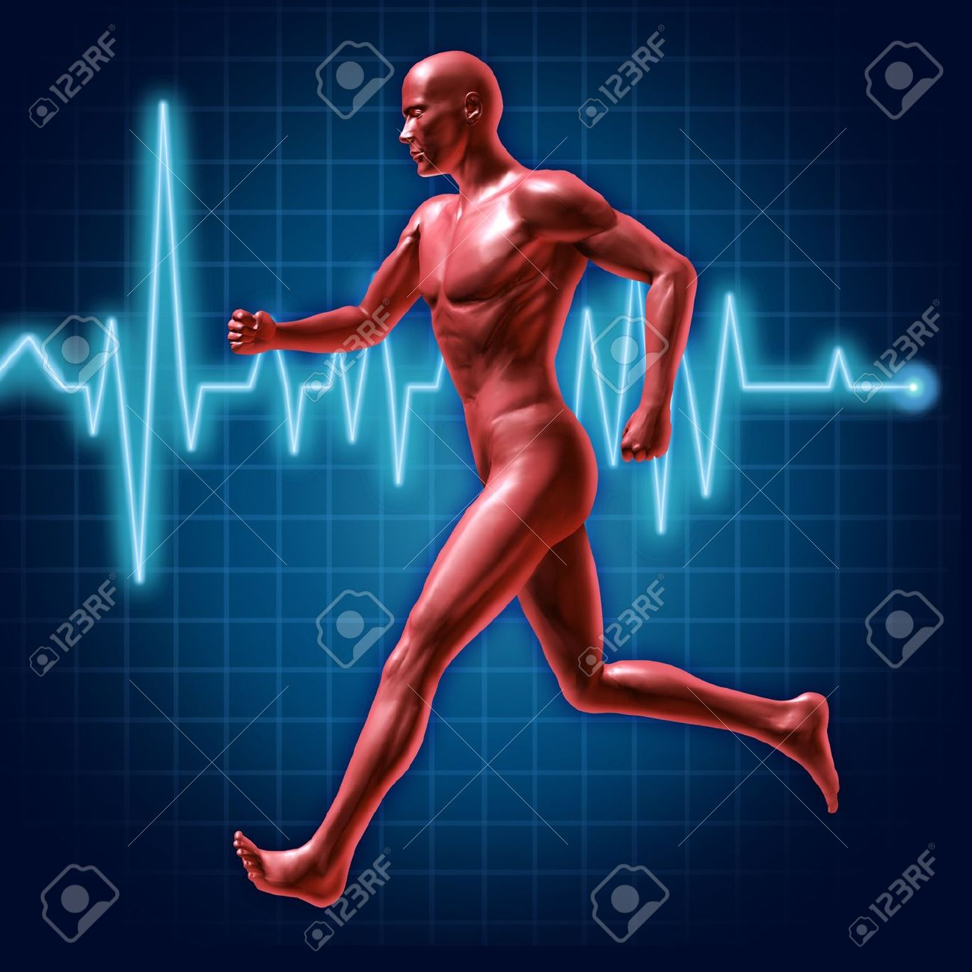
Heart Health
Can restrain cholesterol content of serum
May avoid lipid depositing on vascular wall
Can help to maintain steady blood pressure
Can improve blood circulation
May relieve from artery vasospasm

Slide 12
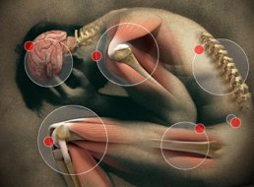
Reduce pain
Can help in migraine headaches
Can reduce back pain
May also help in arthritic pain
Can provide relief from tired
legs

Slide 13
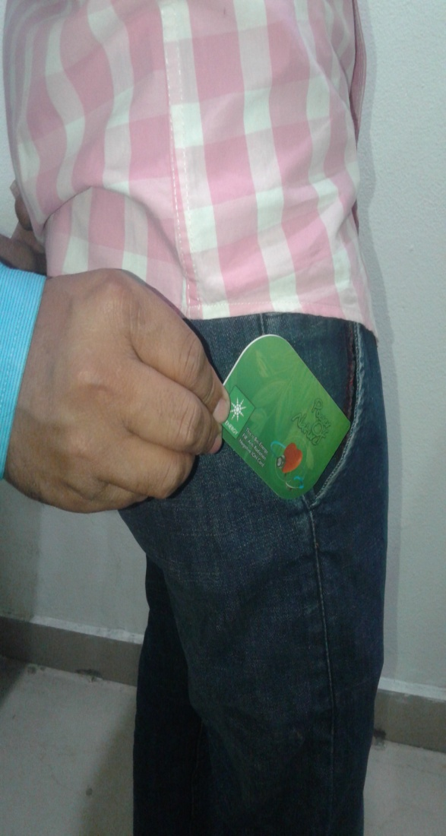
USAGE INSTRUCTIONS
Just put it in your pocket
Ladies just slip in your bra
While sleeping put card under
the pillow
Also you can put your card under
the water glass for energize water

Slide 14
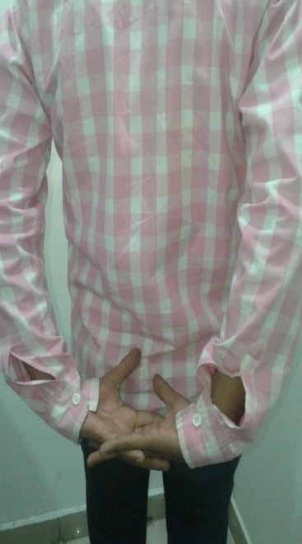
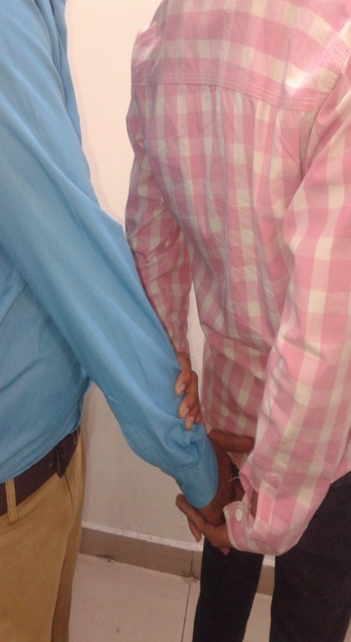
Muscle Test to check Product Quality
Take your hands on back side & make a tight grip
Ask your friend to push down your gripped hands while you resist, they go in downward directions
Then relax & come back to your normal position

Slide 15
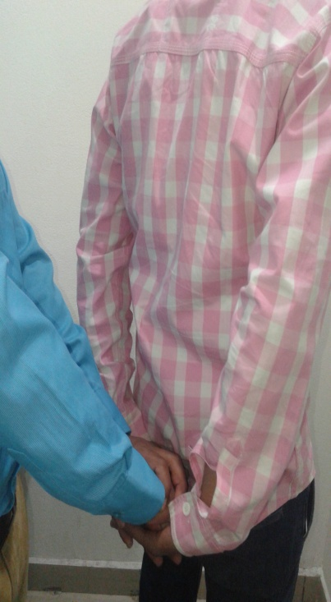
Muscle Test to check Product Quality
Then relax & come back to your normal
position
Put Bioenergy Card in your pocket
Again repeat the same activity, take
both hands back side & make a tight grip
Ask your same friend to push down with
the same strength while you resist
You will notice the hands go less down
in comparison to previous

Slide 16
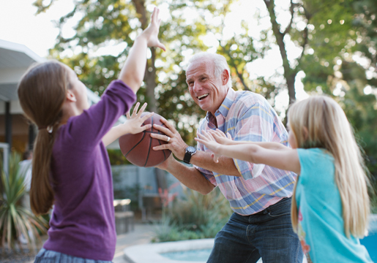
Conclusion
Your hands don’t go down easily due
to increase in muscle strength
It clearly mentioned the instant
inflow of energy in your body after
taking this
If you use this on regular basis then you will notice a big difference in your overall health!

Slide 17
Note: This is not intended to treat, prevent & cure any diseases. Please consult your health professional.

