Slide 1
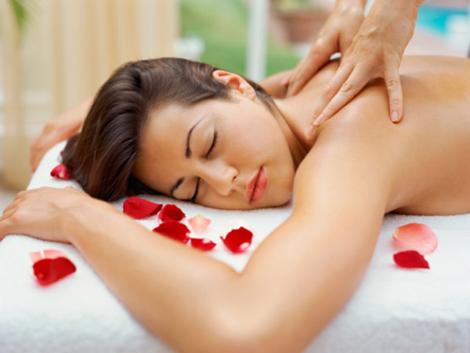
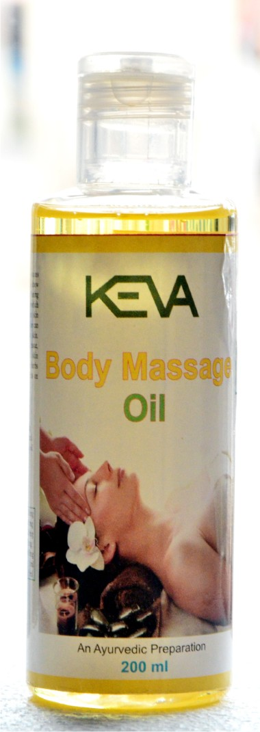
Keva body massage Oil

Slide 2
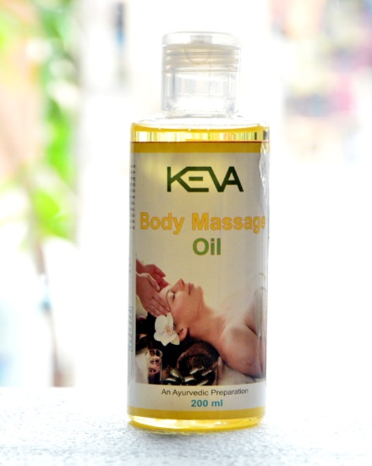
Keva body massage OIL
Specially formulated to enlighten rough, dry & undernourished skin
Improve skin elasticity
Promote silky, smooth & toned skin
May help heal skin tissue, lighten
discoloration & enhance skin radiance
Helps uplift mood & refreshes body
Multi-purpose body oil, leaving no oily residue
Ideal for massage or for use as bath oil, post shaving & as a hand or foot treatment to soothe the skin

Slide 3
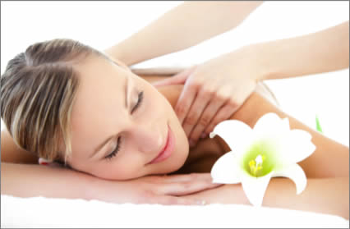
what it contains
Contains internationally acclaimed ingredients known for calming effects on skin
improves skin texture & keep it healthy
Convolvulus pluricaulis
Citrus aurantium dulcis peel
Cinnamomum camphora
Onosma hispidum
Vigna mungo
Cocos nucifera
Almond oil

Slide 4
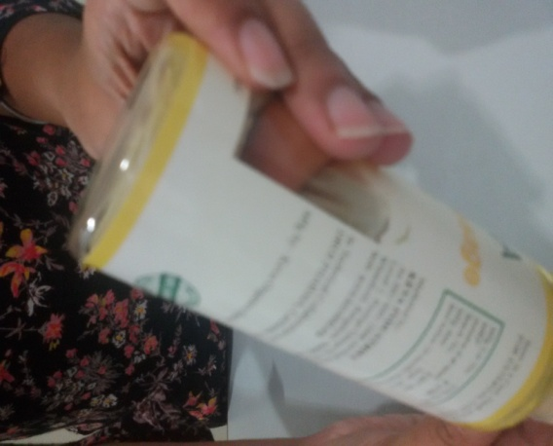
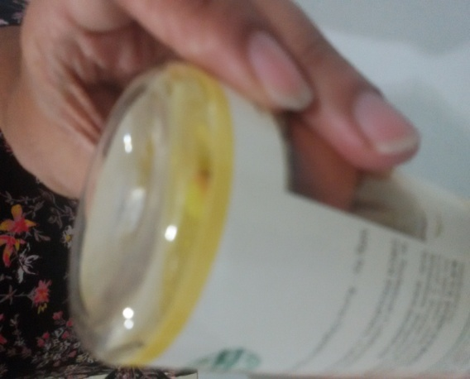
Demo of body massage Oil: To check quality of oil
Flip Over test
When upend (Flip Over) the oil bottle
The entire content flows towards the bottle top part
And no residue will be separately visible on bottom part

Slide 5
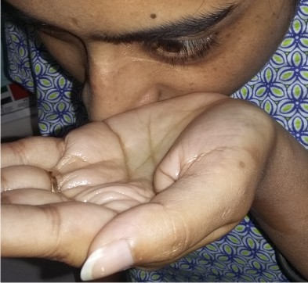
Demo of body massage Oil: To check quality of oil
Eye Test
While putting the oil near to the eyes,
The eyes do not feel irritation
There will be no tears in eyes

Slide 6
CONCLUSION
Shows that Keva Body Massage oil is of
Best quality
Uniformly and properly mixed
Do not stick to bottom of the bottle
Dot not cause any irritation to the eyes

Slide 7
Note: This is not intended to treat, prevent & cure any diseases.

