Slide 1
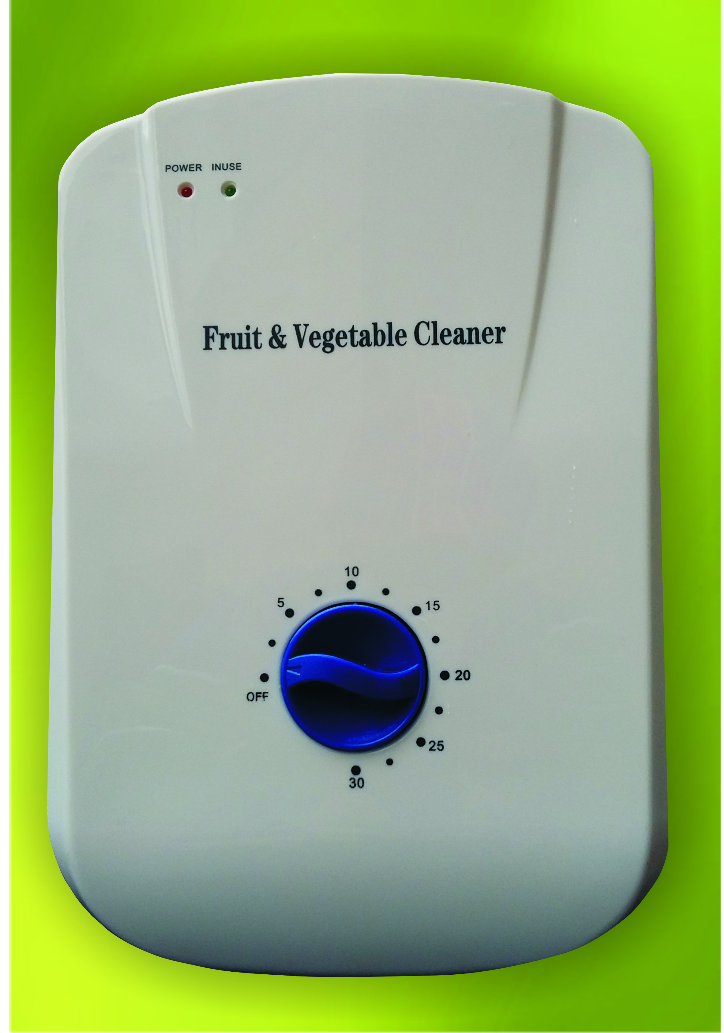
Vegetable
& Fruit Purifier

Slide 2
Vegetable & Fruit Purifier
A Smart Way To Remove Germs, Pesticides & Chemicals From Fruits & Vegetables
Based on Revolutionary Ozone
Disinfection Technology
Keep Your Fruits & Vegetables Fresh

Slide 3
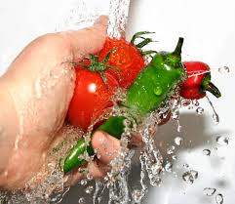
Need of Purifier
Bacteria & viruses lead to
serious health issues
Washing alone is not enough
It washes away all surface
contaminants in few minutes
Makes them healthy to eat

Slide 4
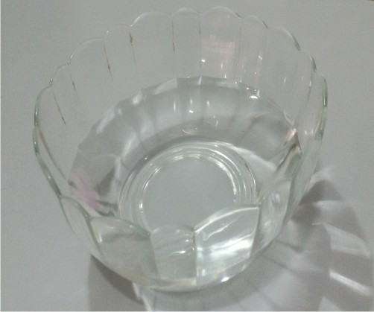
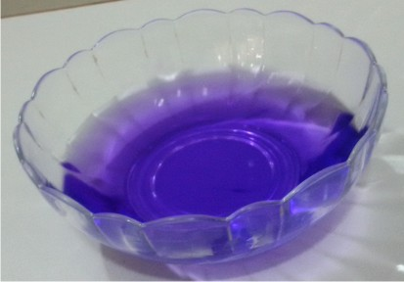
Live Demo to check Product Quality
With Neel
Take a bowl of water
All 1-2 drops of Neel into the water, color of water
changes to blue

Slide 5
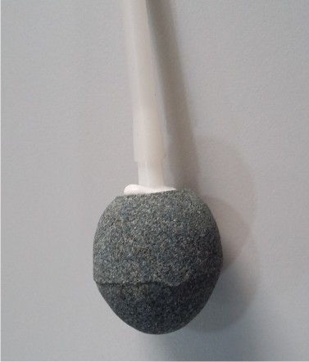
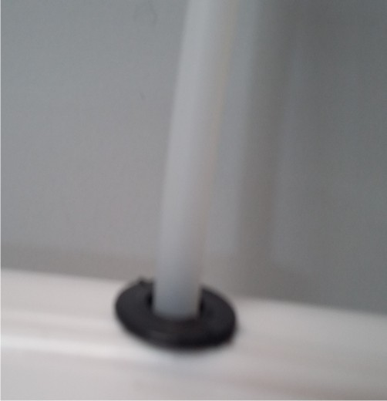
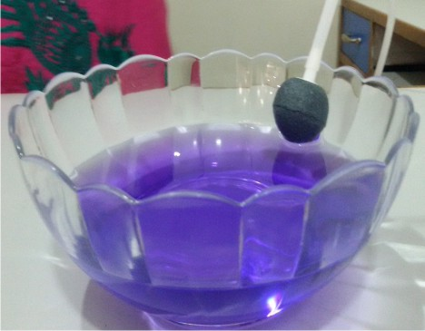
Live Demo to check Product Quality
Then insert one end of air tube to ozone outlet stone and other end to ozone outlet connector
Put the ozone outlet stone in the bowl of Neel water

Slide 6
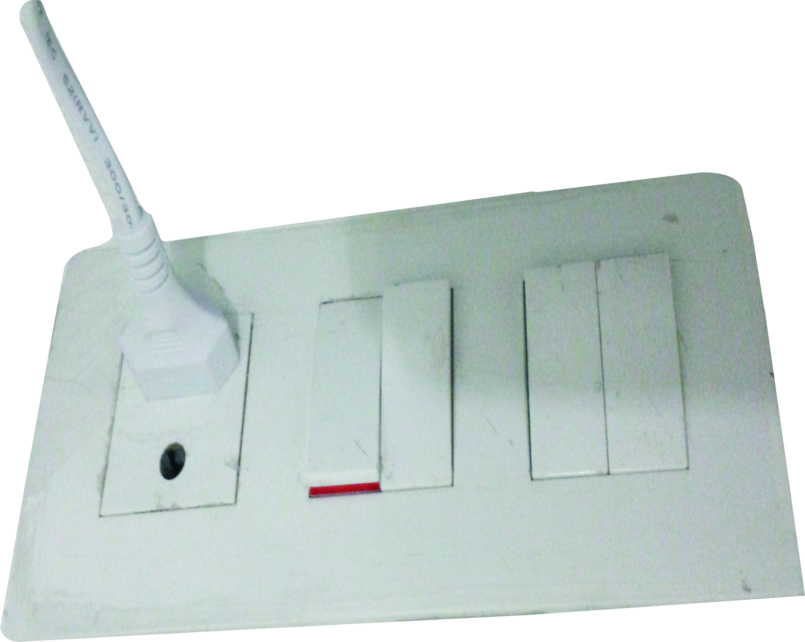
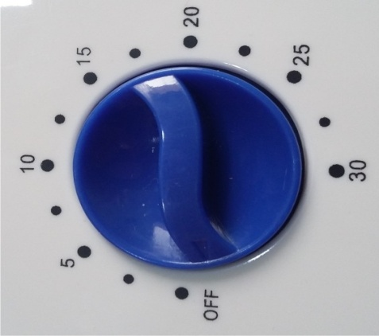
Live Demo to check Product Quality
Connect the machine to power supply
Rotate the timer button to 5 minutes
Then turn the power switch on
Within 2-3 minutes the blue color of water again comes to its normal transparent state
You can perform the same demo with Betadine also

Slide 7
CONCLUSION
The environment is subjected to bacteria and viruses
and the fruits and vegetables come from the same
environment
These eatable if left untreated lead to serious health
complications
Washing alone is not the solution for getting rid of
those deadly bacteria and viruses
Vegetable and Fruit Purifier is based on Revolutionary
Ozone Disinfection Technology produces highly
reactive Ozone gas that successfully oxidizes traces of
pesticides, insecticides and other harmful farm
chemicals thereby, making food fit for human
consumption

