Slide 1
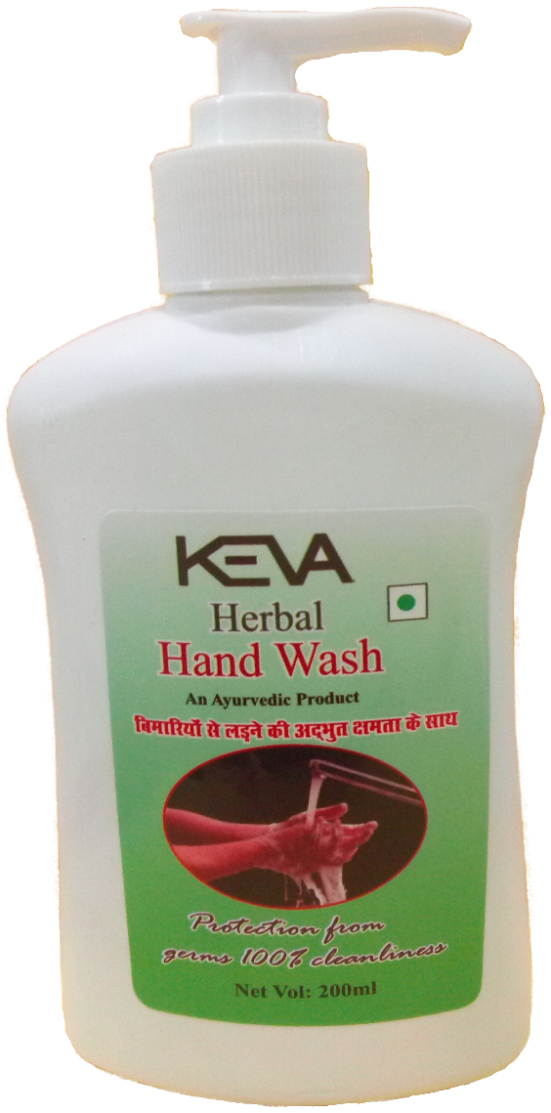
Keva Industries has launched
Keva
Herbal
Hand Wash
MRP: Rs. 119/-
Pack Size: 200 ml

Slide 2
Keva Herbal Hand Wash
Keva Herbal Hand wash is formulated with natural herbal extracts that gently cleanse & leave hands smooth & soft.

Slide 3
Keva Herbal Hand Wash
Herbal blend help to moisturize skin, neutralize strong food odors & can eliminate up to 99.99 percent of surface bacteria after washing.

Slide 4
Keva Herbal Hand Wash
Wonderful ingredients incorporated in this are known to have potent antimicrobial, antibacterial, fungicidal & antiviral properties, safely keep viruses, bacteria & fungi at bay.

Slide 5
Keva Herbal Hand Wash
Can eliminate surface bacteria, toxins, dirt
Nourish & moisturize skin
Non-drying formula leave hands feeling conditioned, soft & smooth
Complement the natural pH of skin
Can neutralize food odors like onions, garlic, fish etc

Slide 6
Keva Herbal Hand Wash
Biodegradable formula
Have Antifungal, Antibacterial, Antimicrobial properties
Tulsi oil is endowed with antiseptic & purifying qualities which help to prevent skin diseases
Can protect against everyday germs that can cause skin infections, respiratory infections (Influenza), Gastroenteritis etc

Slide 7
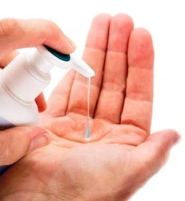
Keva Herbal Hand Wash
Press nozzle gently to get Keva Liquid Hand Wash on the wet hands, then rinse properly & dry off.

Slide 8
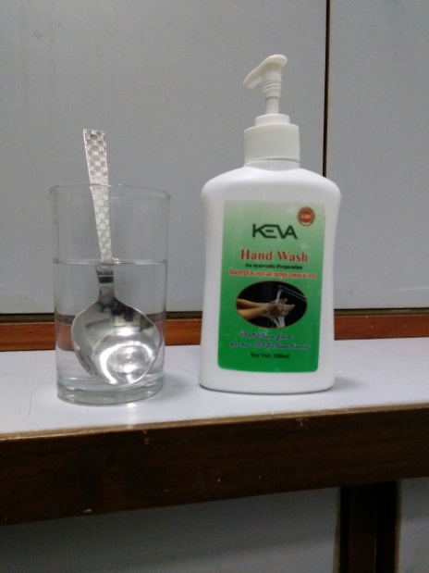
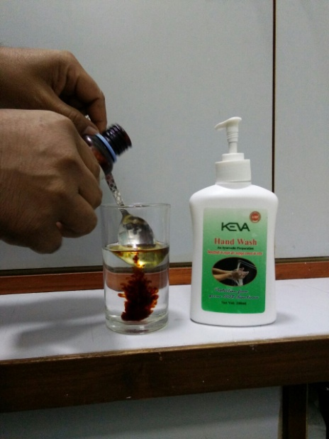
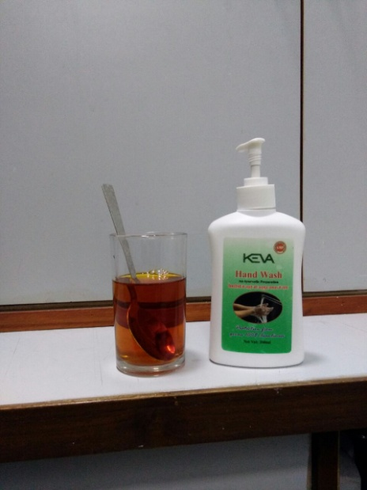
Demo of Keva Herbal Hand Wash
Take a glass of fresh water
Add 1 tablespoon of Betadine which leads to change the color of water to red, which shows the presence of harmful chemical

Slide 9
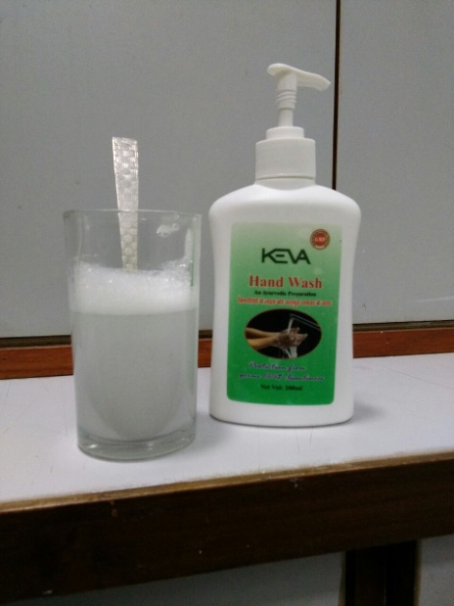
Demo of Keva Herbal Hand Wash
When we add few drops of Keva Herbal Hand Wash to Betadine containing water then again the water comes to its normal transparent appearance.

Slide 10
Demo of Keva Herbal Hand Wash
This shows that it can eliminate surface bacteria, dirt, pollution & disinfect hands from infection causing germs.

Slide 11
Keva Herbal Hand Wash
Using it every day can protect hands from germs & keep them hygienically clean & refreshed. Wash hands properly with Keva Herbal Hand Wash & help keep your family healthy.

Slide 12
Contact
Keva Industries Level 2, Prestige Omega, No. 104, EPIP Zone, Whitefield, Bangalore - 560066 (India)
Website : www.kevaind.org

Slide 13
Thank You

