Slide 1
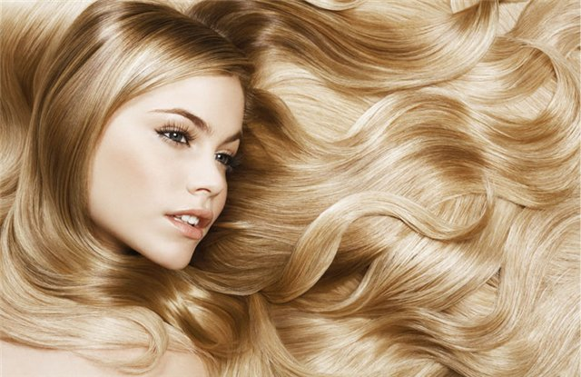
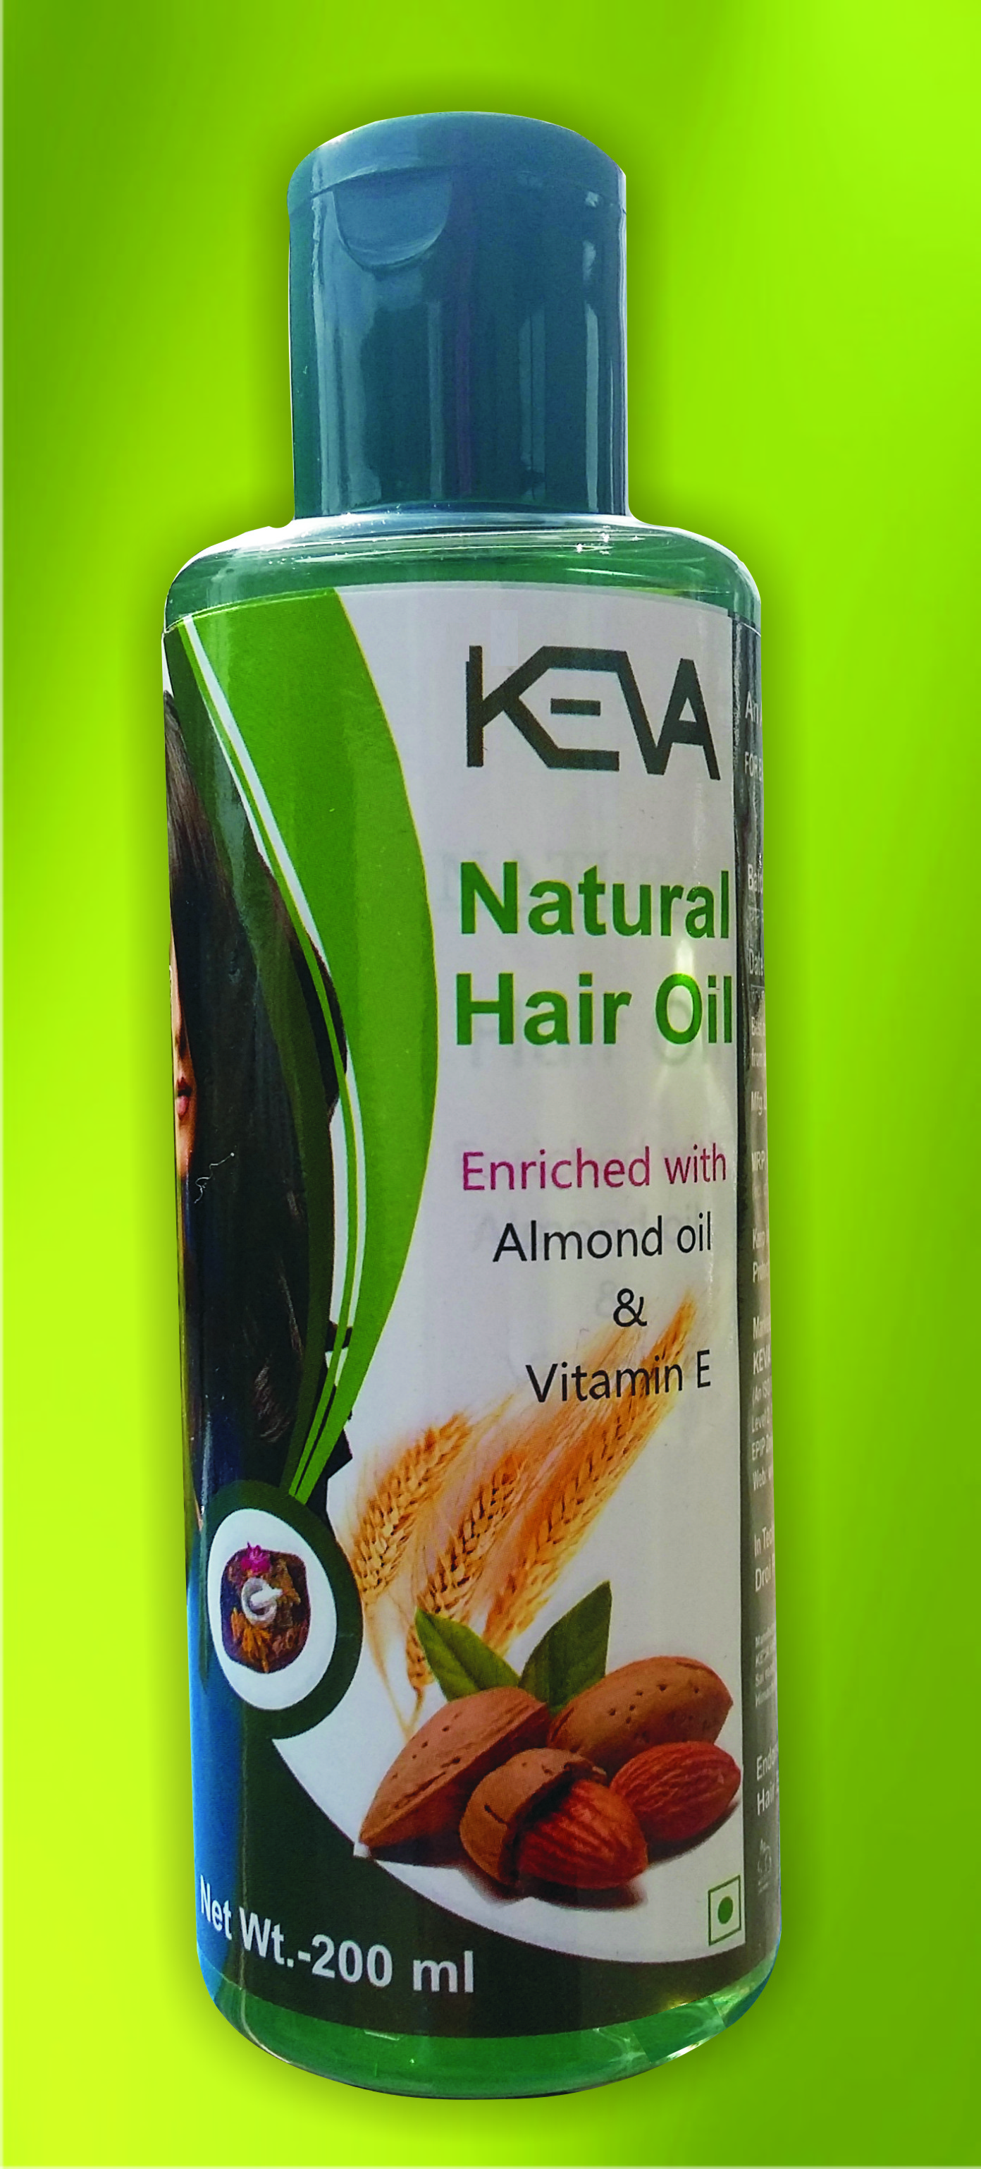
Keva Natural Hair Oil
By Keva Industries

Slide 2
NATURAL HAIR OIL
Non Sticky Hair Oil
Enriched with unique blend of herbs that penetrates deep into the scalp to nourish the hair roots
Provides nourishment to the hair from the roots to the tips
Prevents hair loss and helps control dandruff
Helps in reducing premature graying
Improves the hair texture and adds luster to the hair

Slide 3
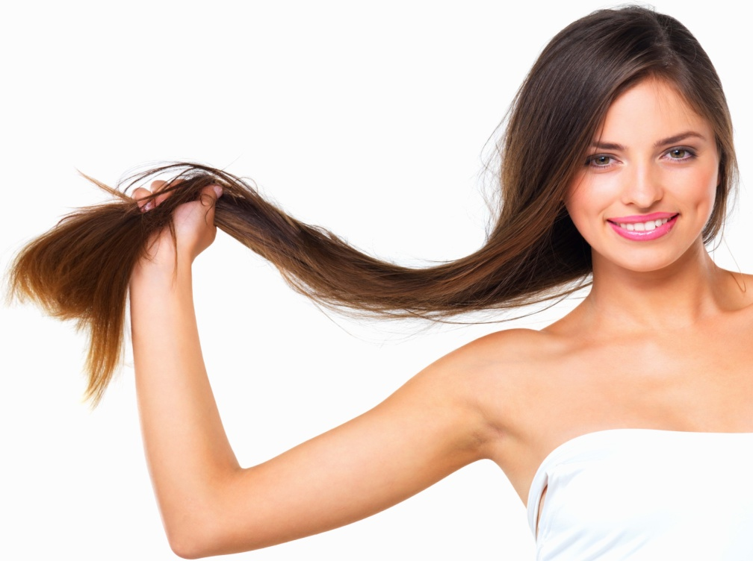
Enriched with herbal ingredients
Amla (Phyllanthus emblica)
Shikakai (Acacia rugata)
Bhringraj (Eclipta alba)
Brahmi (Bacopa monnierri)
Almond Oil (Prunus amygdalus)
Wheat Germ Oil (Triticum aestivum)
Til Oil (Sesamum indicum)
Arnica Montana
Tea Tree Oil
Nourish and protect hairs

Slide 4
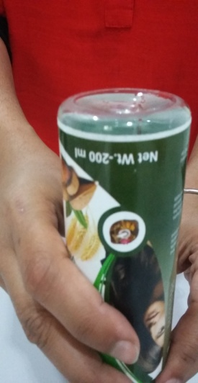
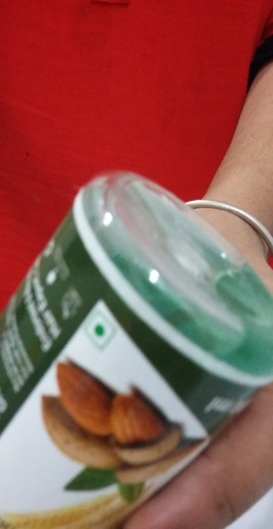
Demo of Natural Hair Oil: To check quality of hair oil
Flip Over test
When upend (Flip Over) the hair oil bottle
The entire content flows towards the bottle top part
And no residue or any green color will be separately visible on bottle part

Slide 5
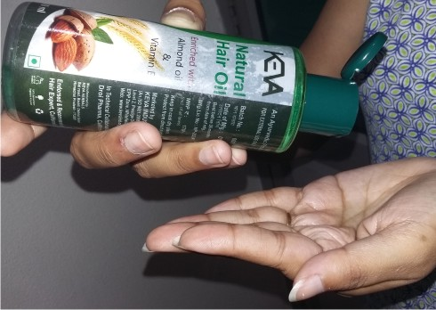
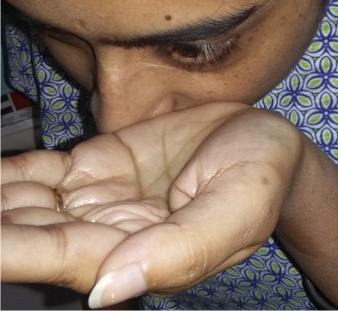
Demo of Natural Hair Oil: To check quality of hair oil
Eye Test
While putting the oil near to the eyes,
The eyes do not feel irritation
There will be no tears in eyes

Slide 6
CONCLUSION
Shows that Natural Hair oil is of
Best quality
Uniformly and properly mixed
Do not stick to bottom of the bottle
Dot not cause any irritation to the eyes

