Slide 1
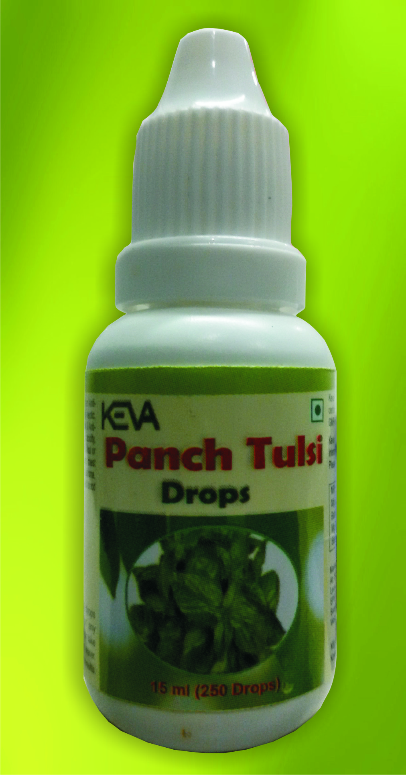
Keva PANCH Tulsi DROPS
By Keva Industries

Slide 2
Keva Panch tulsi drops
Highly Concentrated Natural extract of 5 types of Tulsi
Loaded with antioxidants & other
life supporting nutrients
Eliminate out toxins from the body
Boost immune system functioning
Prevent from flu, fever, cough, cold etc

Slide 3
DEMO TO CHECK PANCH tulsi Drops quality
Betadine test
Show how well Keva Panch Tulsi drops prevent us from harmful free radicals produced in our body due to unhealthy diet, sedentary lifestyle or pollution

Slide 4
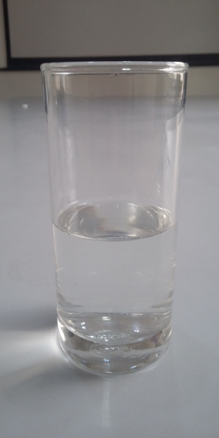
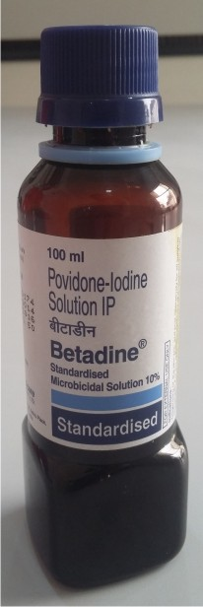
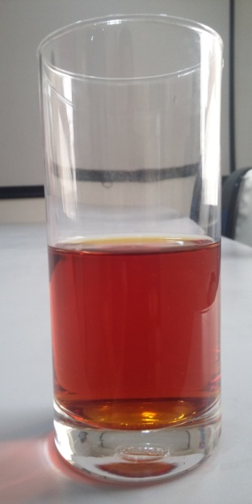
Betadine Test
Take a glass of fresh water
Add 1 tablespoon of Betadine, color of water changes to red
+
Change in color of water shows the presence of harmful chemical and thus creates harmful free radicals in body if we go for any chemical based medicinal treatments during any illness

Slide 5
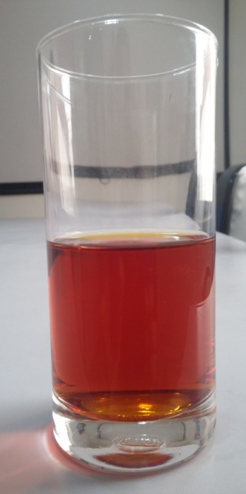
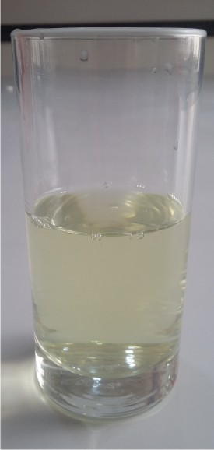
Betadine Test
Add around 15ml Panch Tulsi Drops in that Betadine
containing water then again the water comes to its
normal transparent appearance

Slide 6
Conclusion
Shows that Panch Tulsi provide strong
Anti Oxidant effects
Can naturally detoxify your body from
disease causing harmful free radicals
And in future there will be fewer chances
of problems in the body

