Slide 1
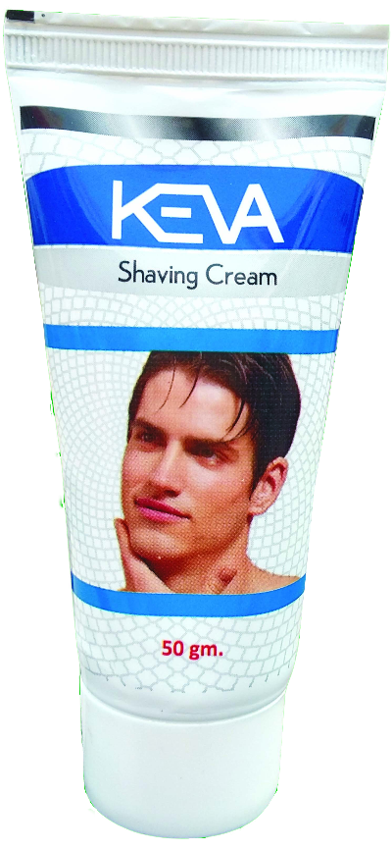
Keva Industries has launched
Keva
Shaving Cream
MRP: Rs. 59/-
Pack Size: 50 g

Slide 2
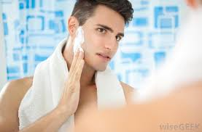
Keva Shaving Cream
With unique herbals ingredients Keva Shaving Cream offers comfortable shave for all skin types,
provides clean shave with no irritation & gives smooth effect on skin.

Slide 3
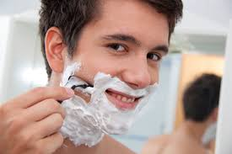
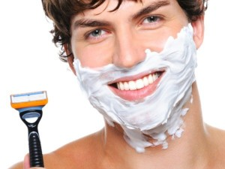
Keva Shaving Cream
Amplified with very unique combination of herbs & active ingredients this product will help restore moisture & protect your skin to enhance your daily performance.

Slide 4
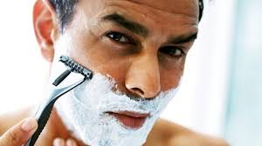
Keva Shaving Cream
It contains an exclusive blend of ingredients specially formulated to provide protection for your skin provides close shave & has soothing effects.

Slide 5
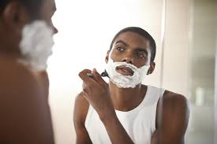
How to use Keva Shaving Cream?
Wet face & apply few drops of shaving cream with the help of brush, form lather, shave & rinse well with water.

Slide 6
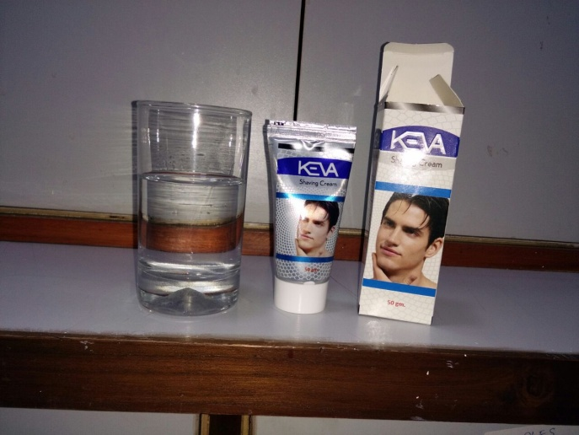
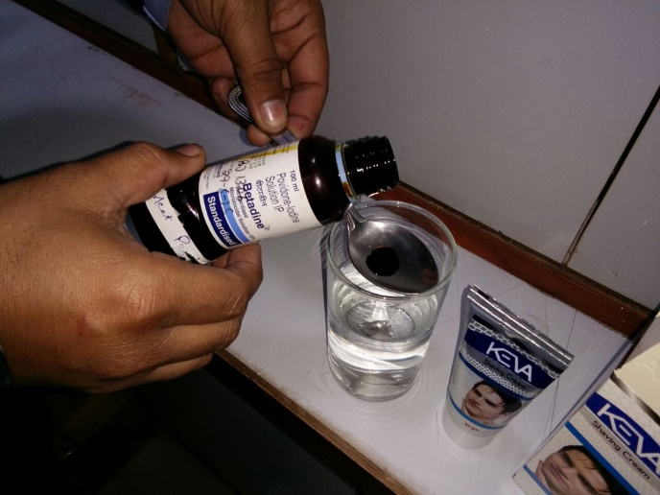
Demo of Keva Shaving Cream
Take a glass of fresh water
Add 1 tablespoon of Betadine which leads to change the color of water to red, which shows the presence of harmful chemical.

Slide 7
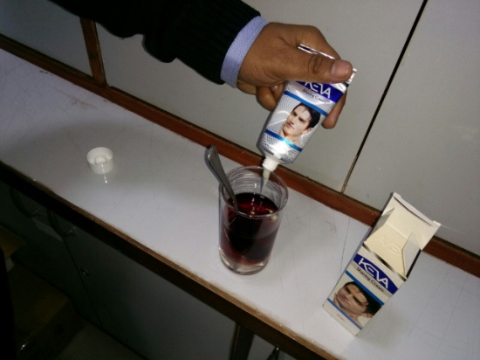
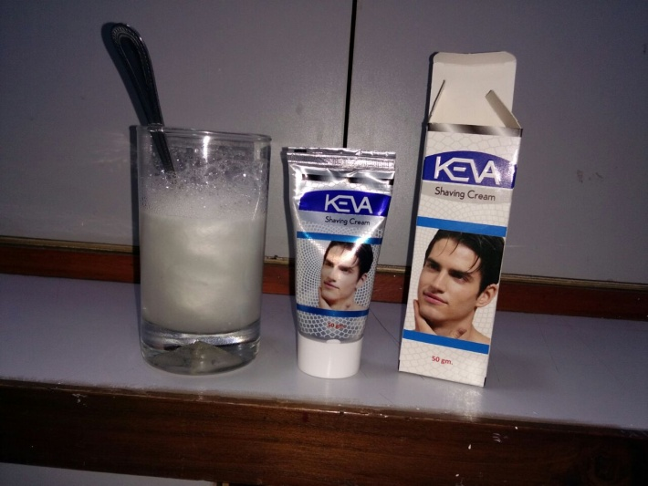
Demo of Keva Shaving Cream
When we add few drops of Keva Shaving Cream to Betadine containing water then again the water comes to its normal transparent appearance.

Slide 8
Demo of Keva Shaving Cream
If you accidently cut your skin while making shave then there are more changes of infection on the cut.
This demo shows that Keva Shaving Cream helps in preserving the health of skin by disinfecting it from harmful toxins, infection causing bacteria & dirt.

Slide 9
Contact
Keva Industries Level 2, Prestige Omega, No. 104, EPIP Zone, Whitefield, Bangalore - 560066 (India)
Website : www.kevaind.org

Slide 10
Thank
You

